Slide 1
Energy Efficiency Analysis
Group 6 : ChihHao Luca Yuan, Ching Yu Hsu

Slide 2
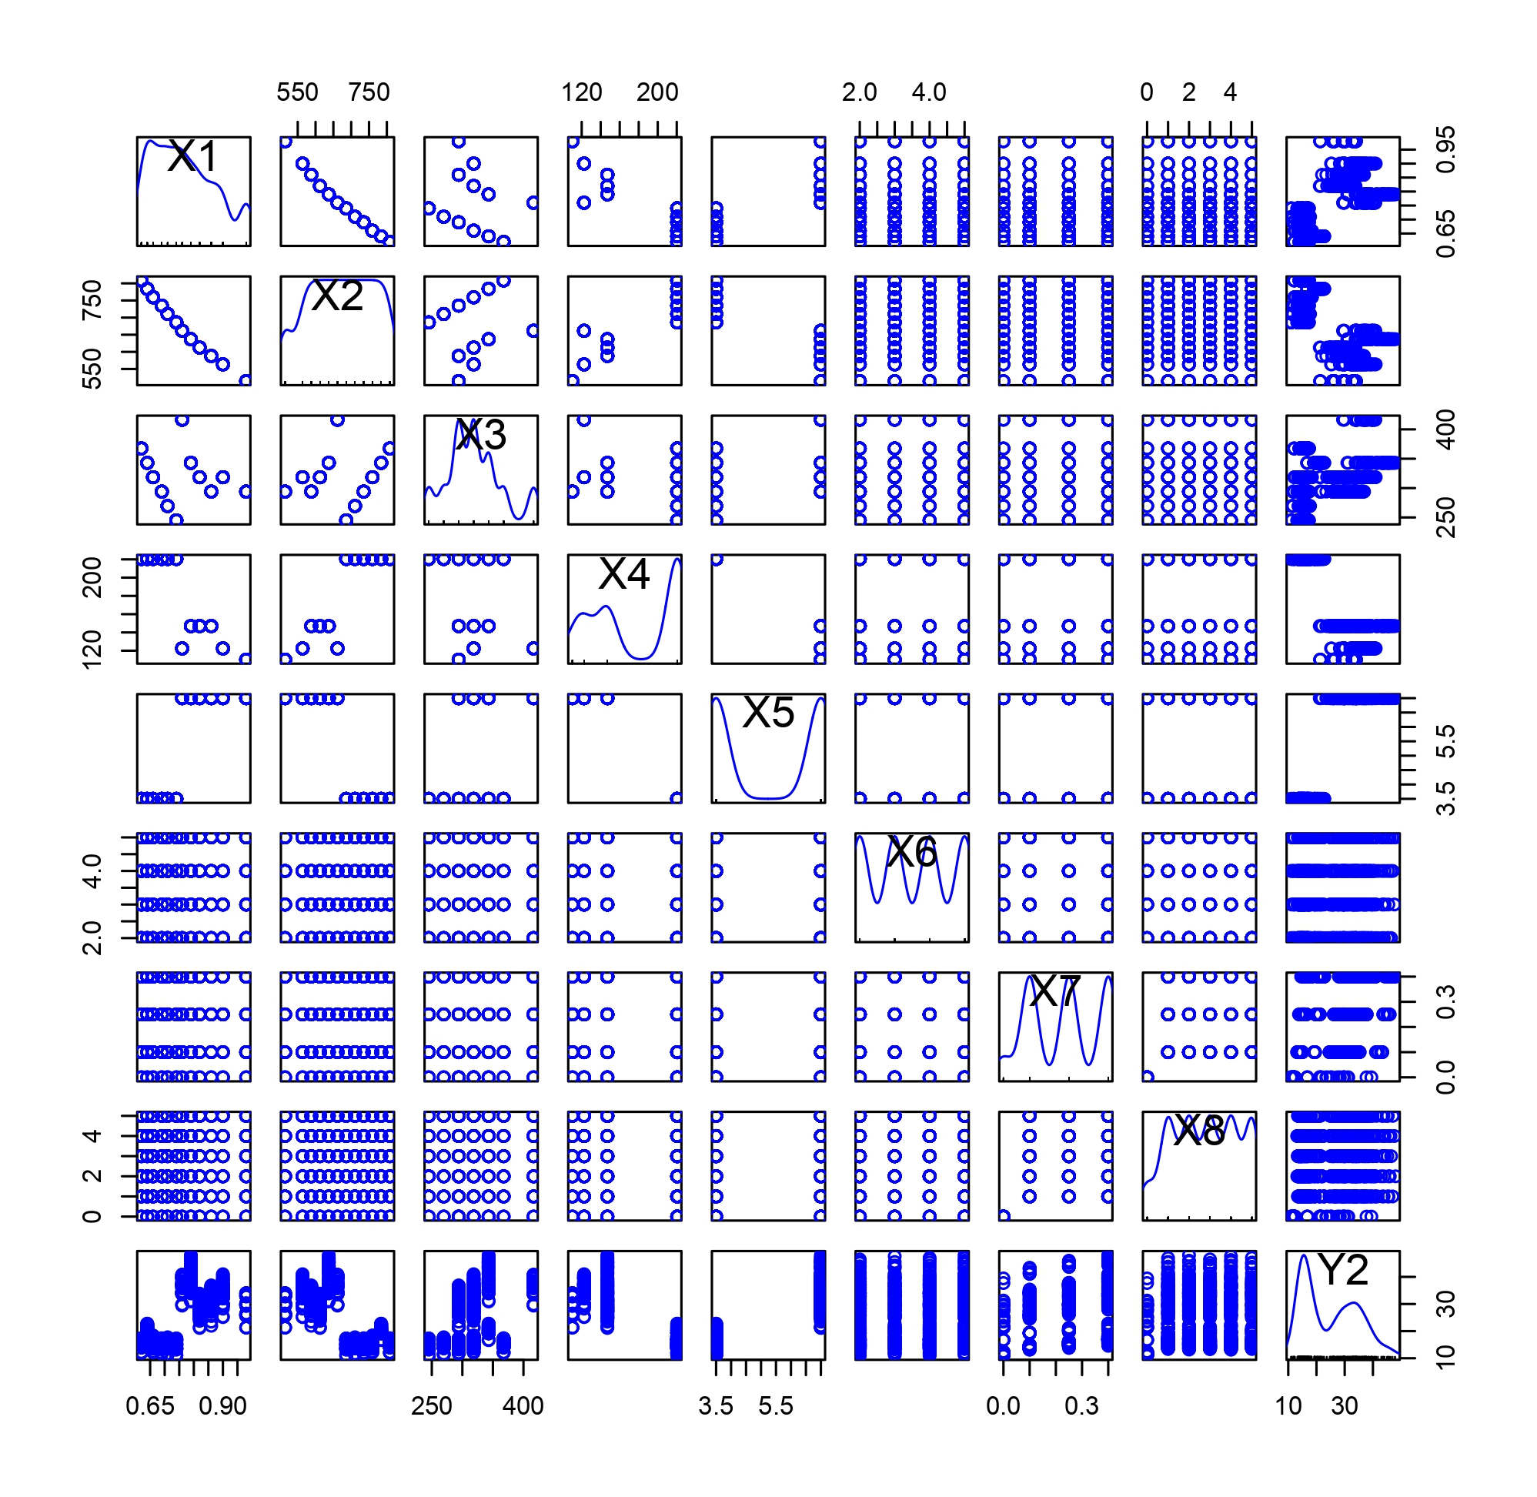
1a)- Scatterplots to display relationships

Slide 3
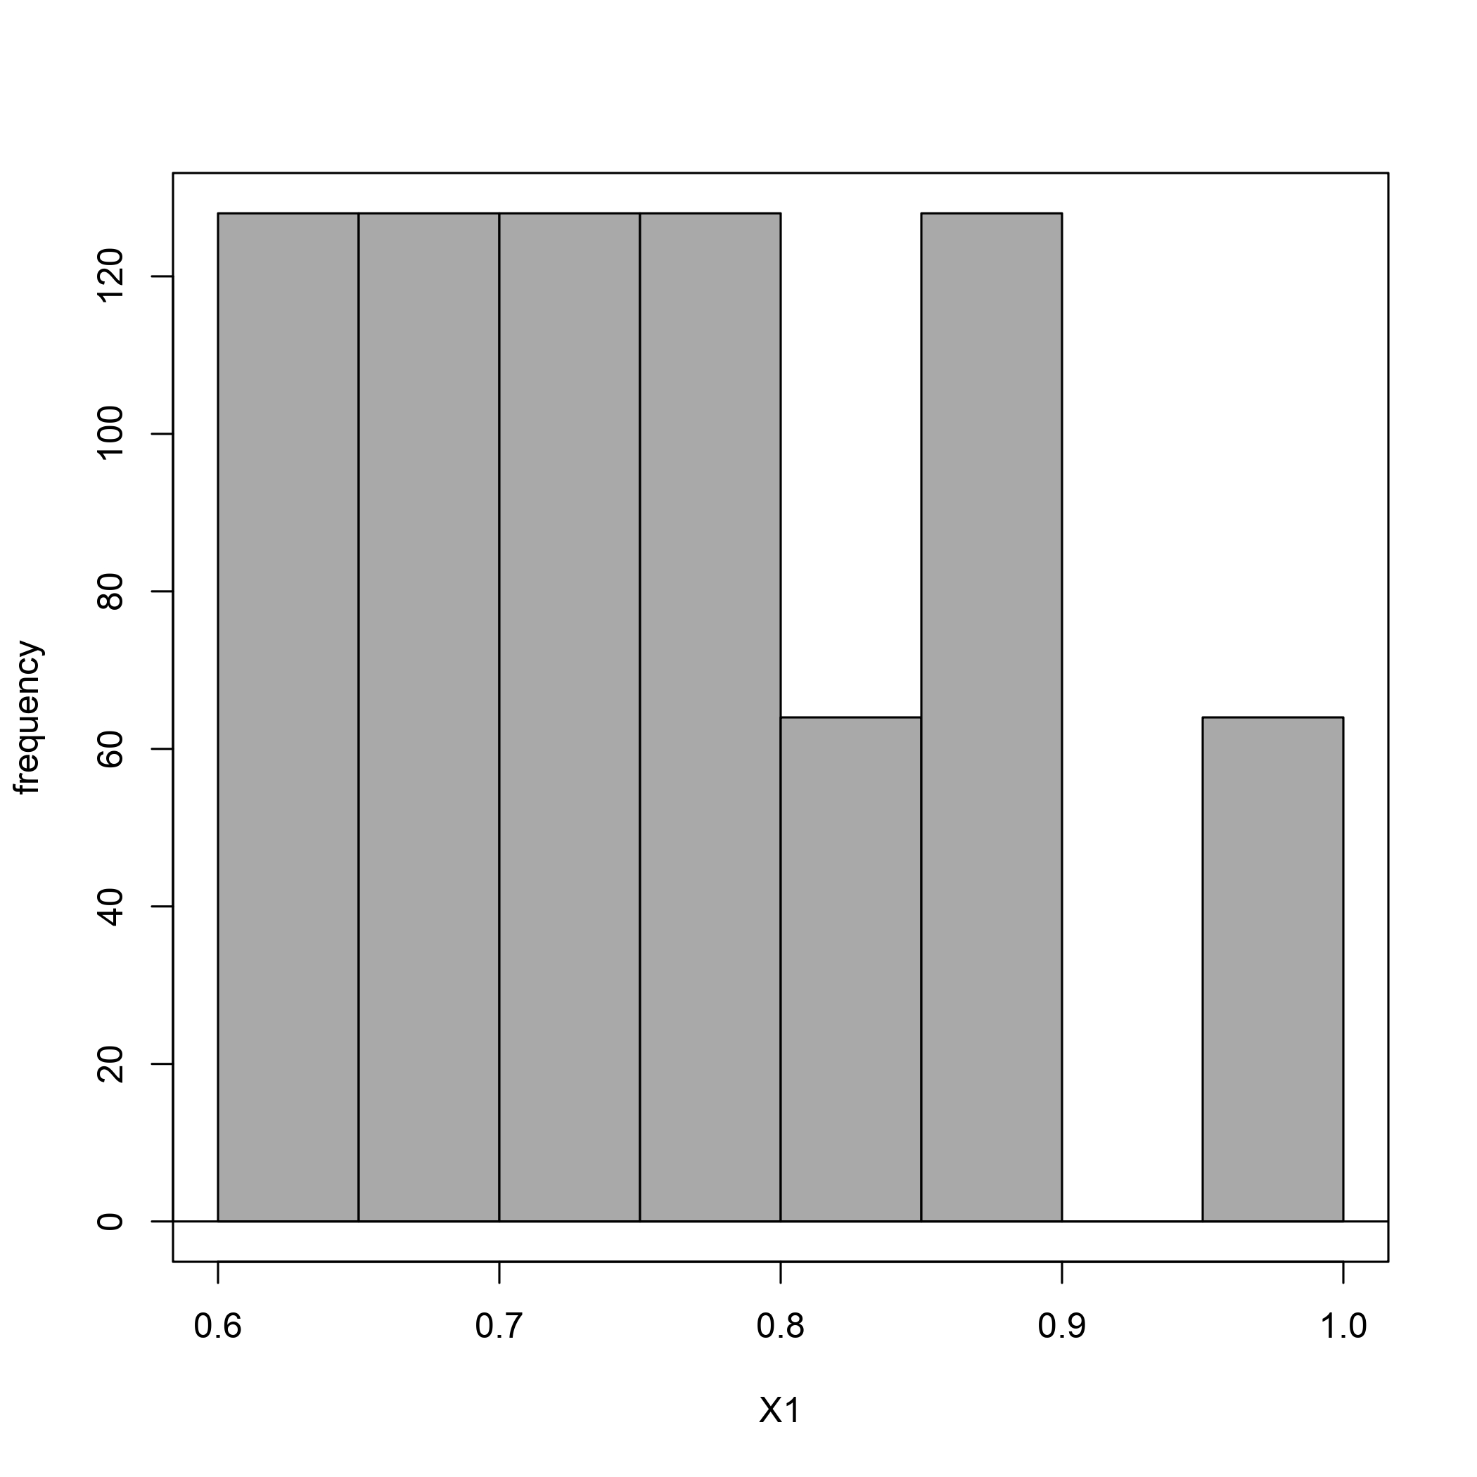
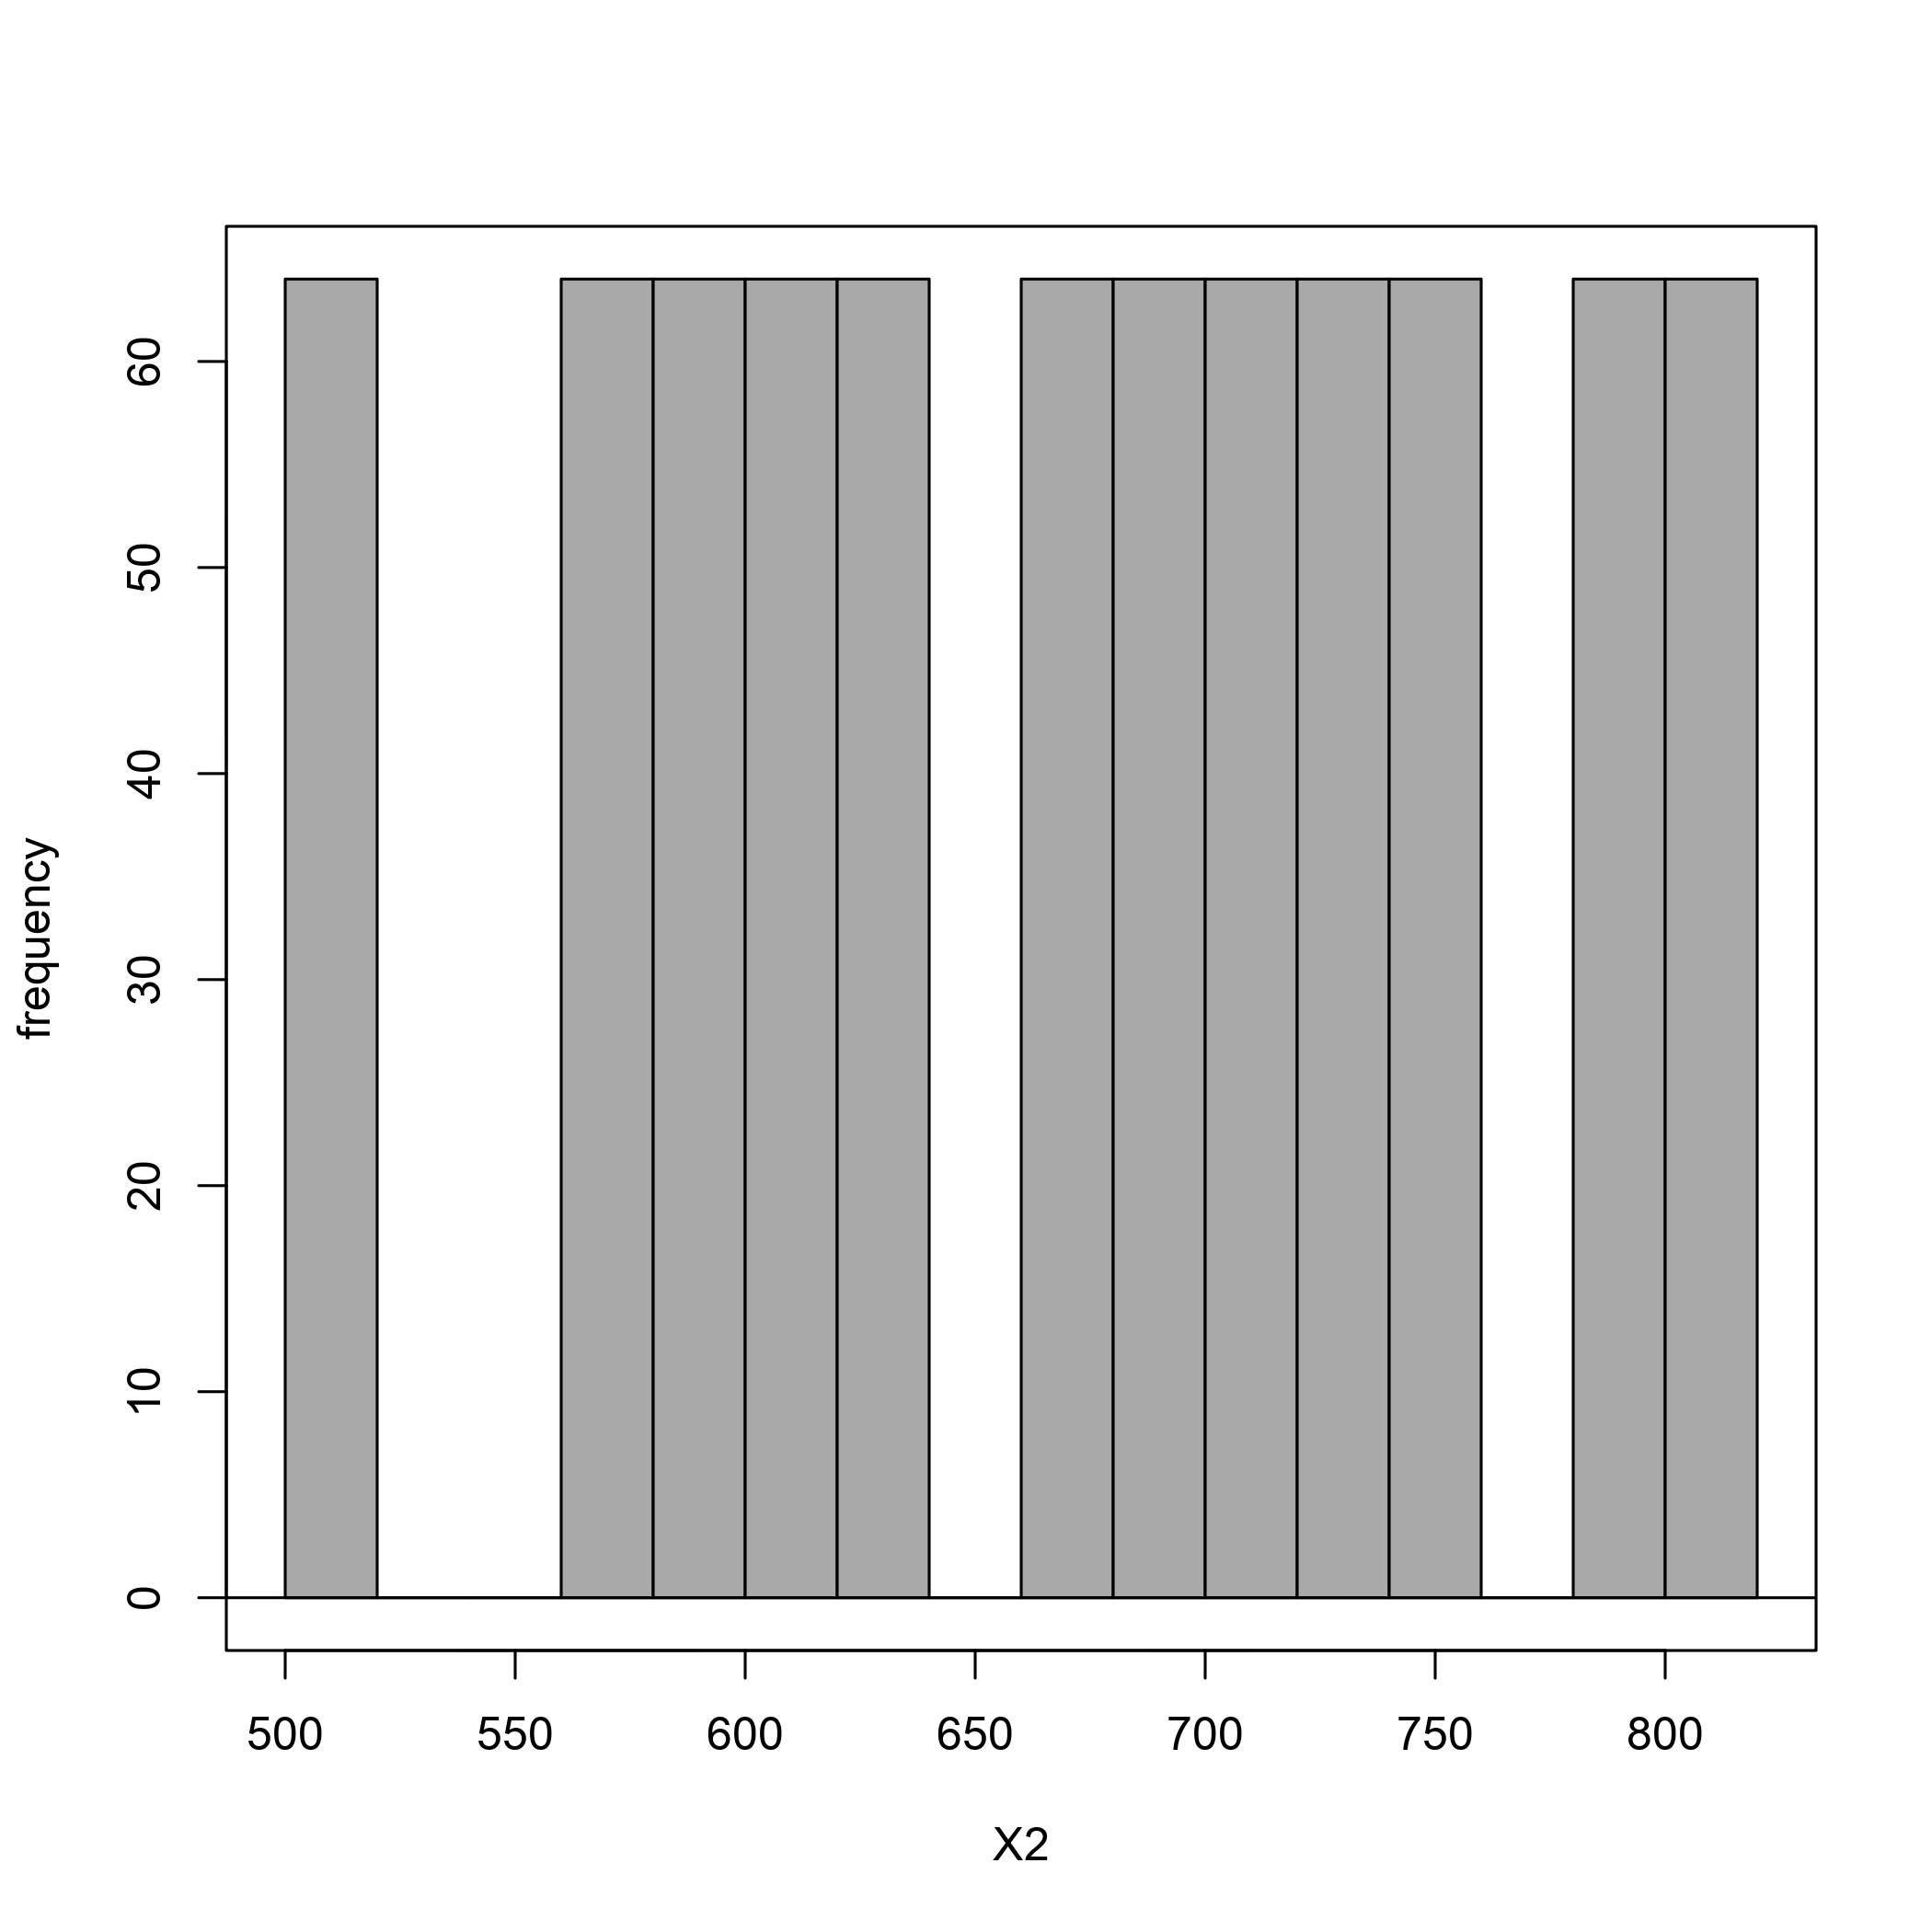
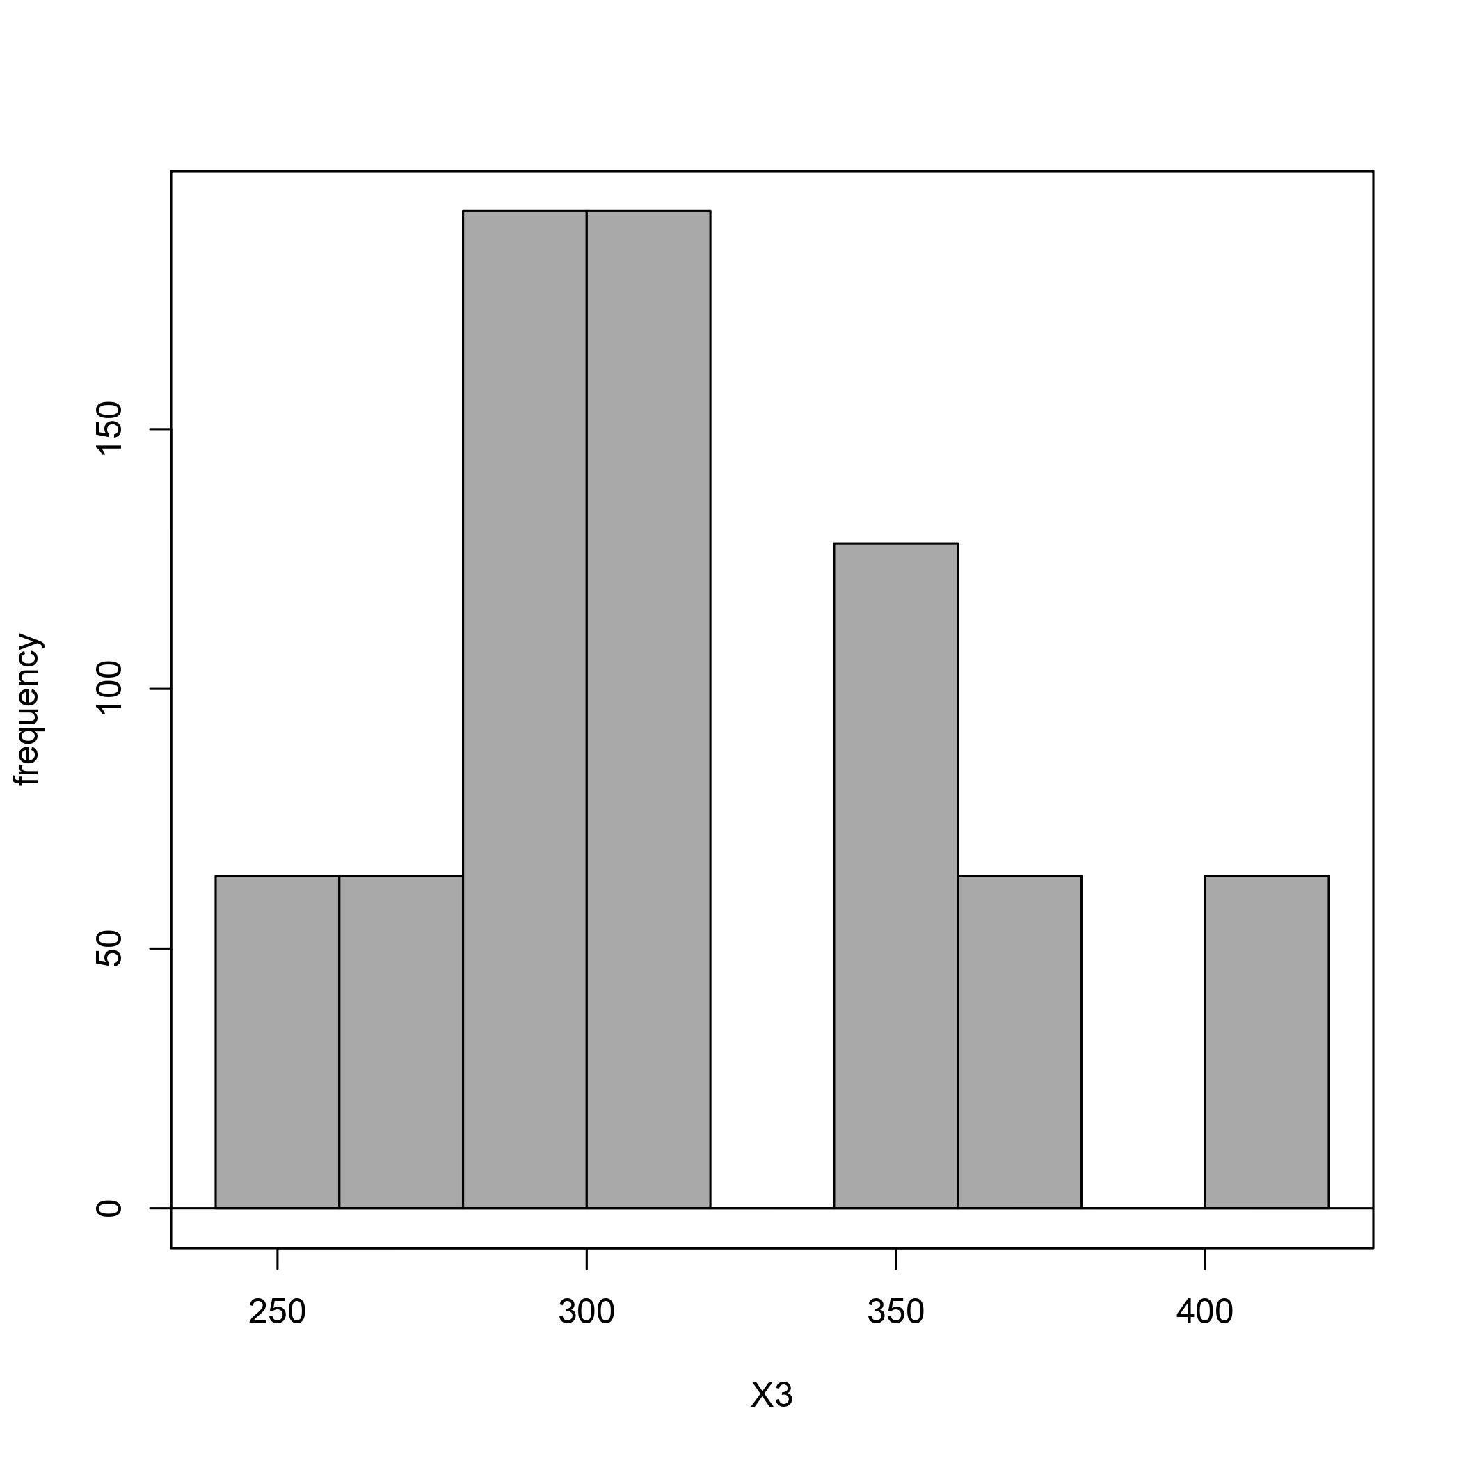
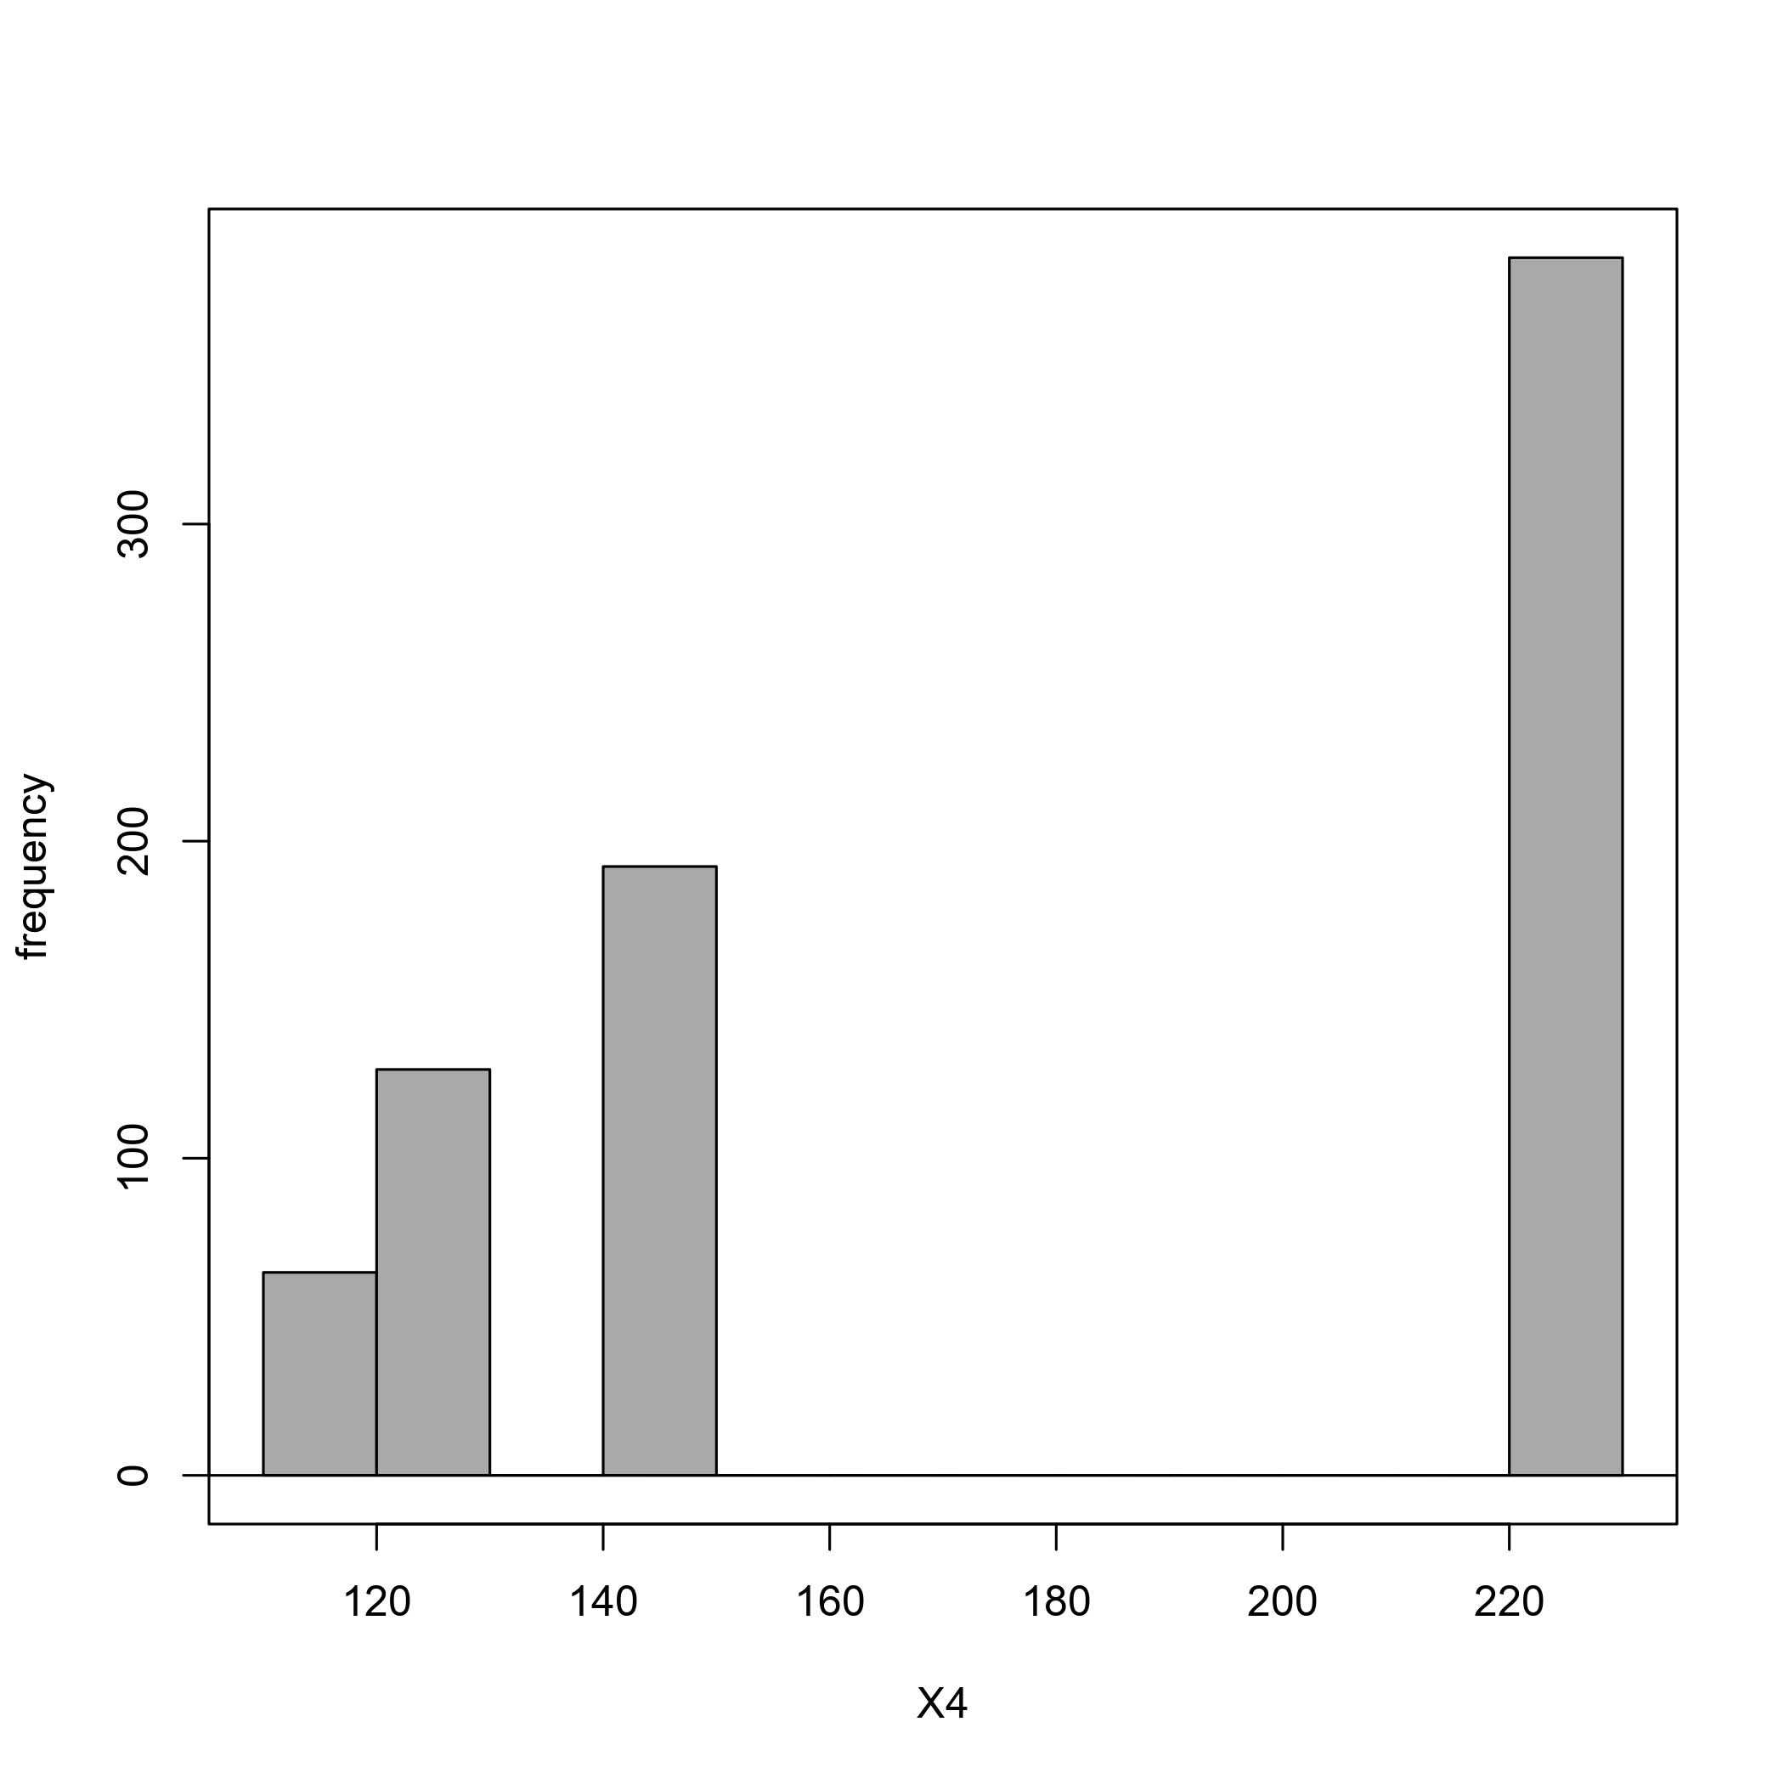
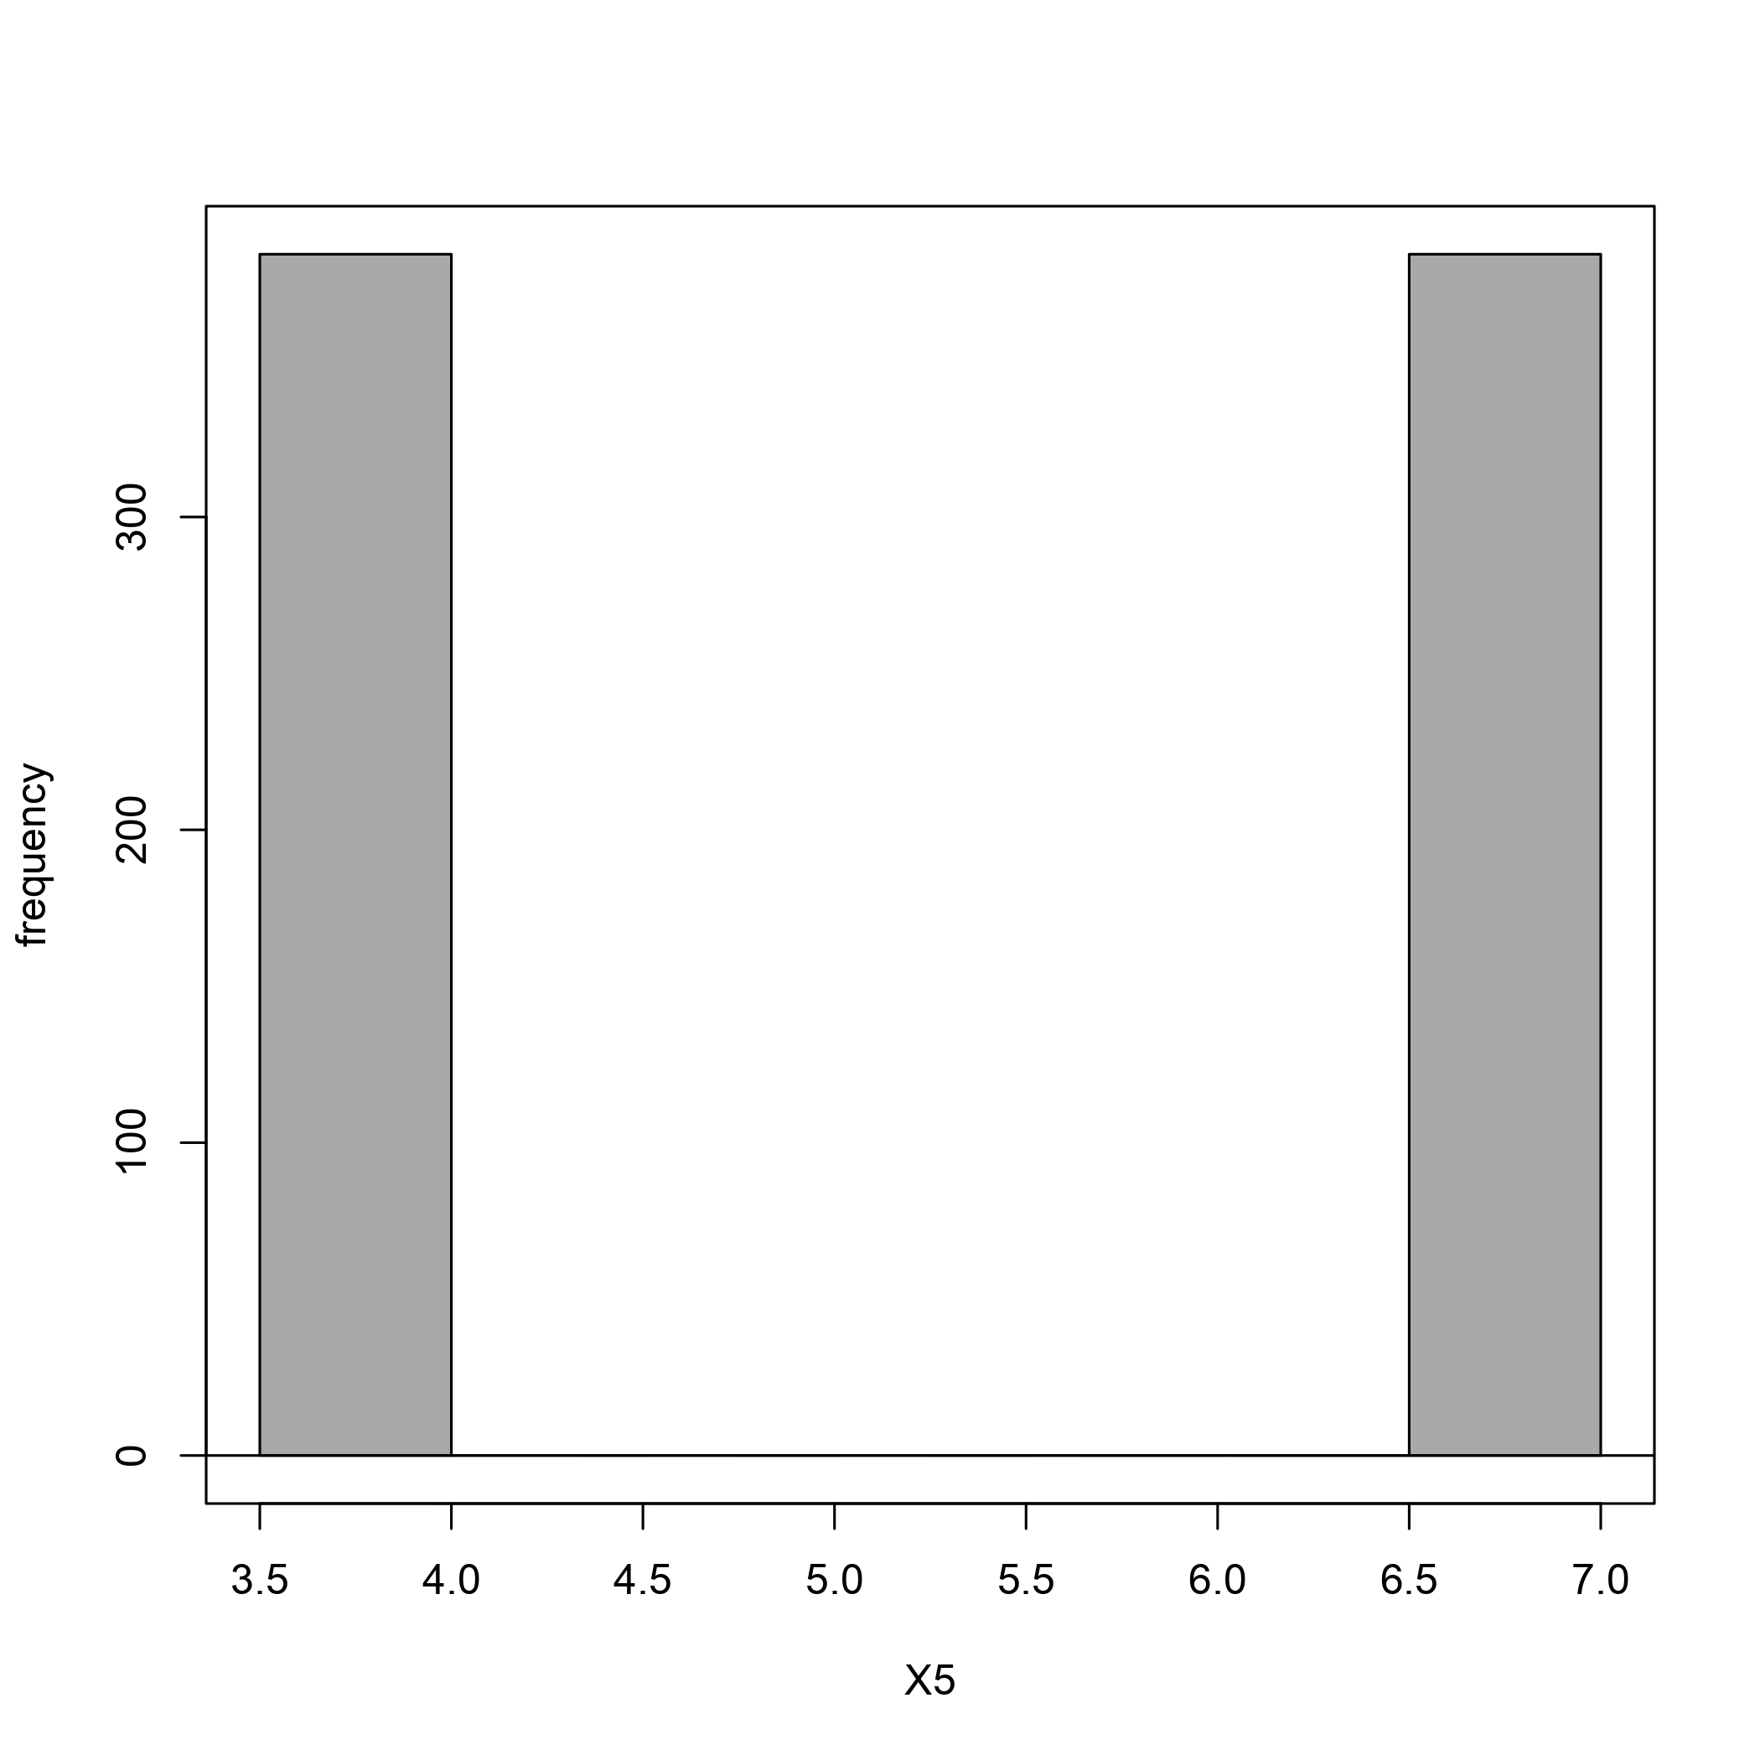
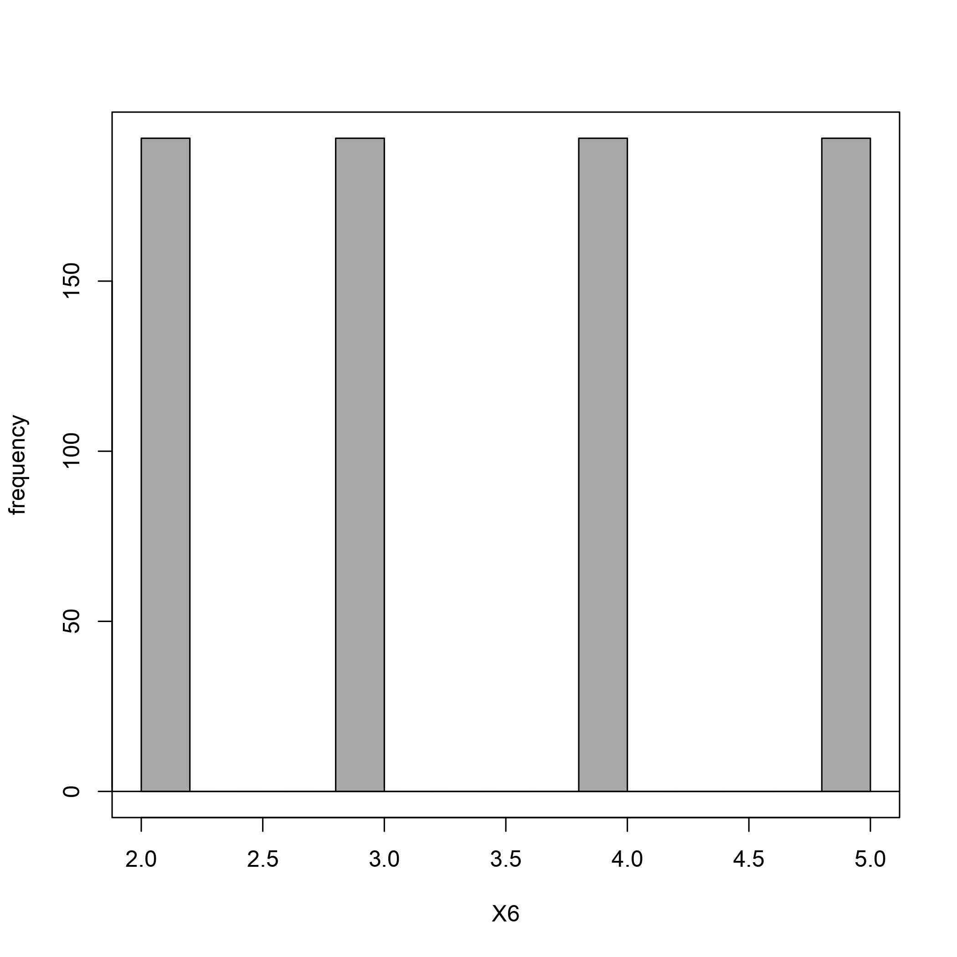
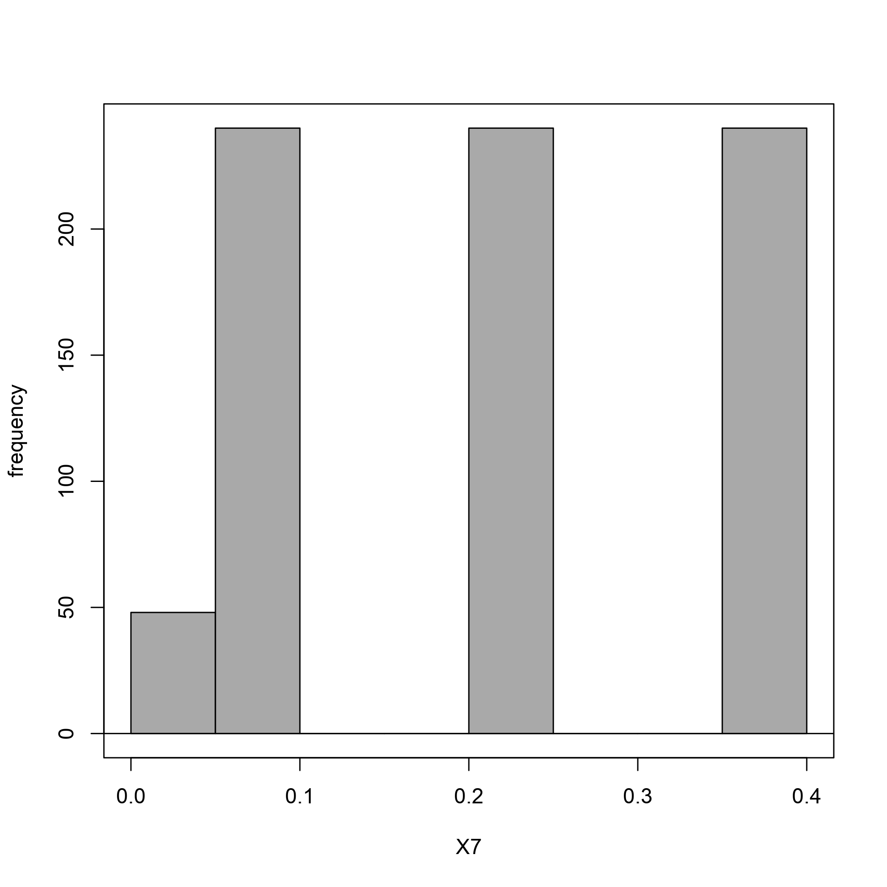
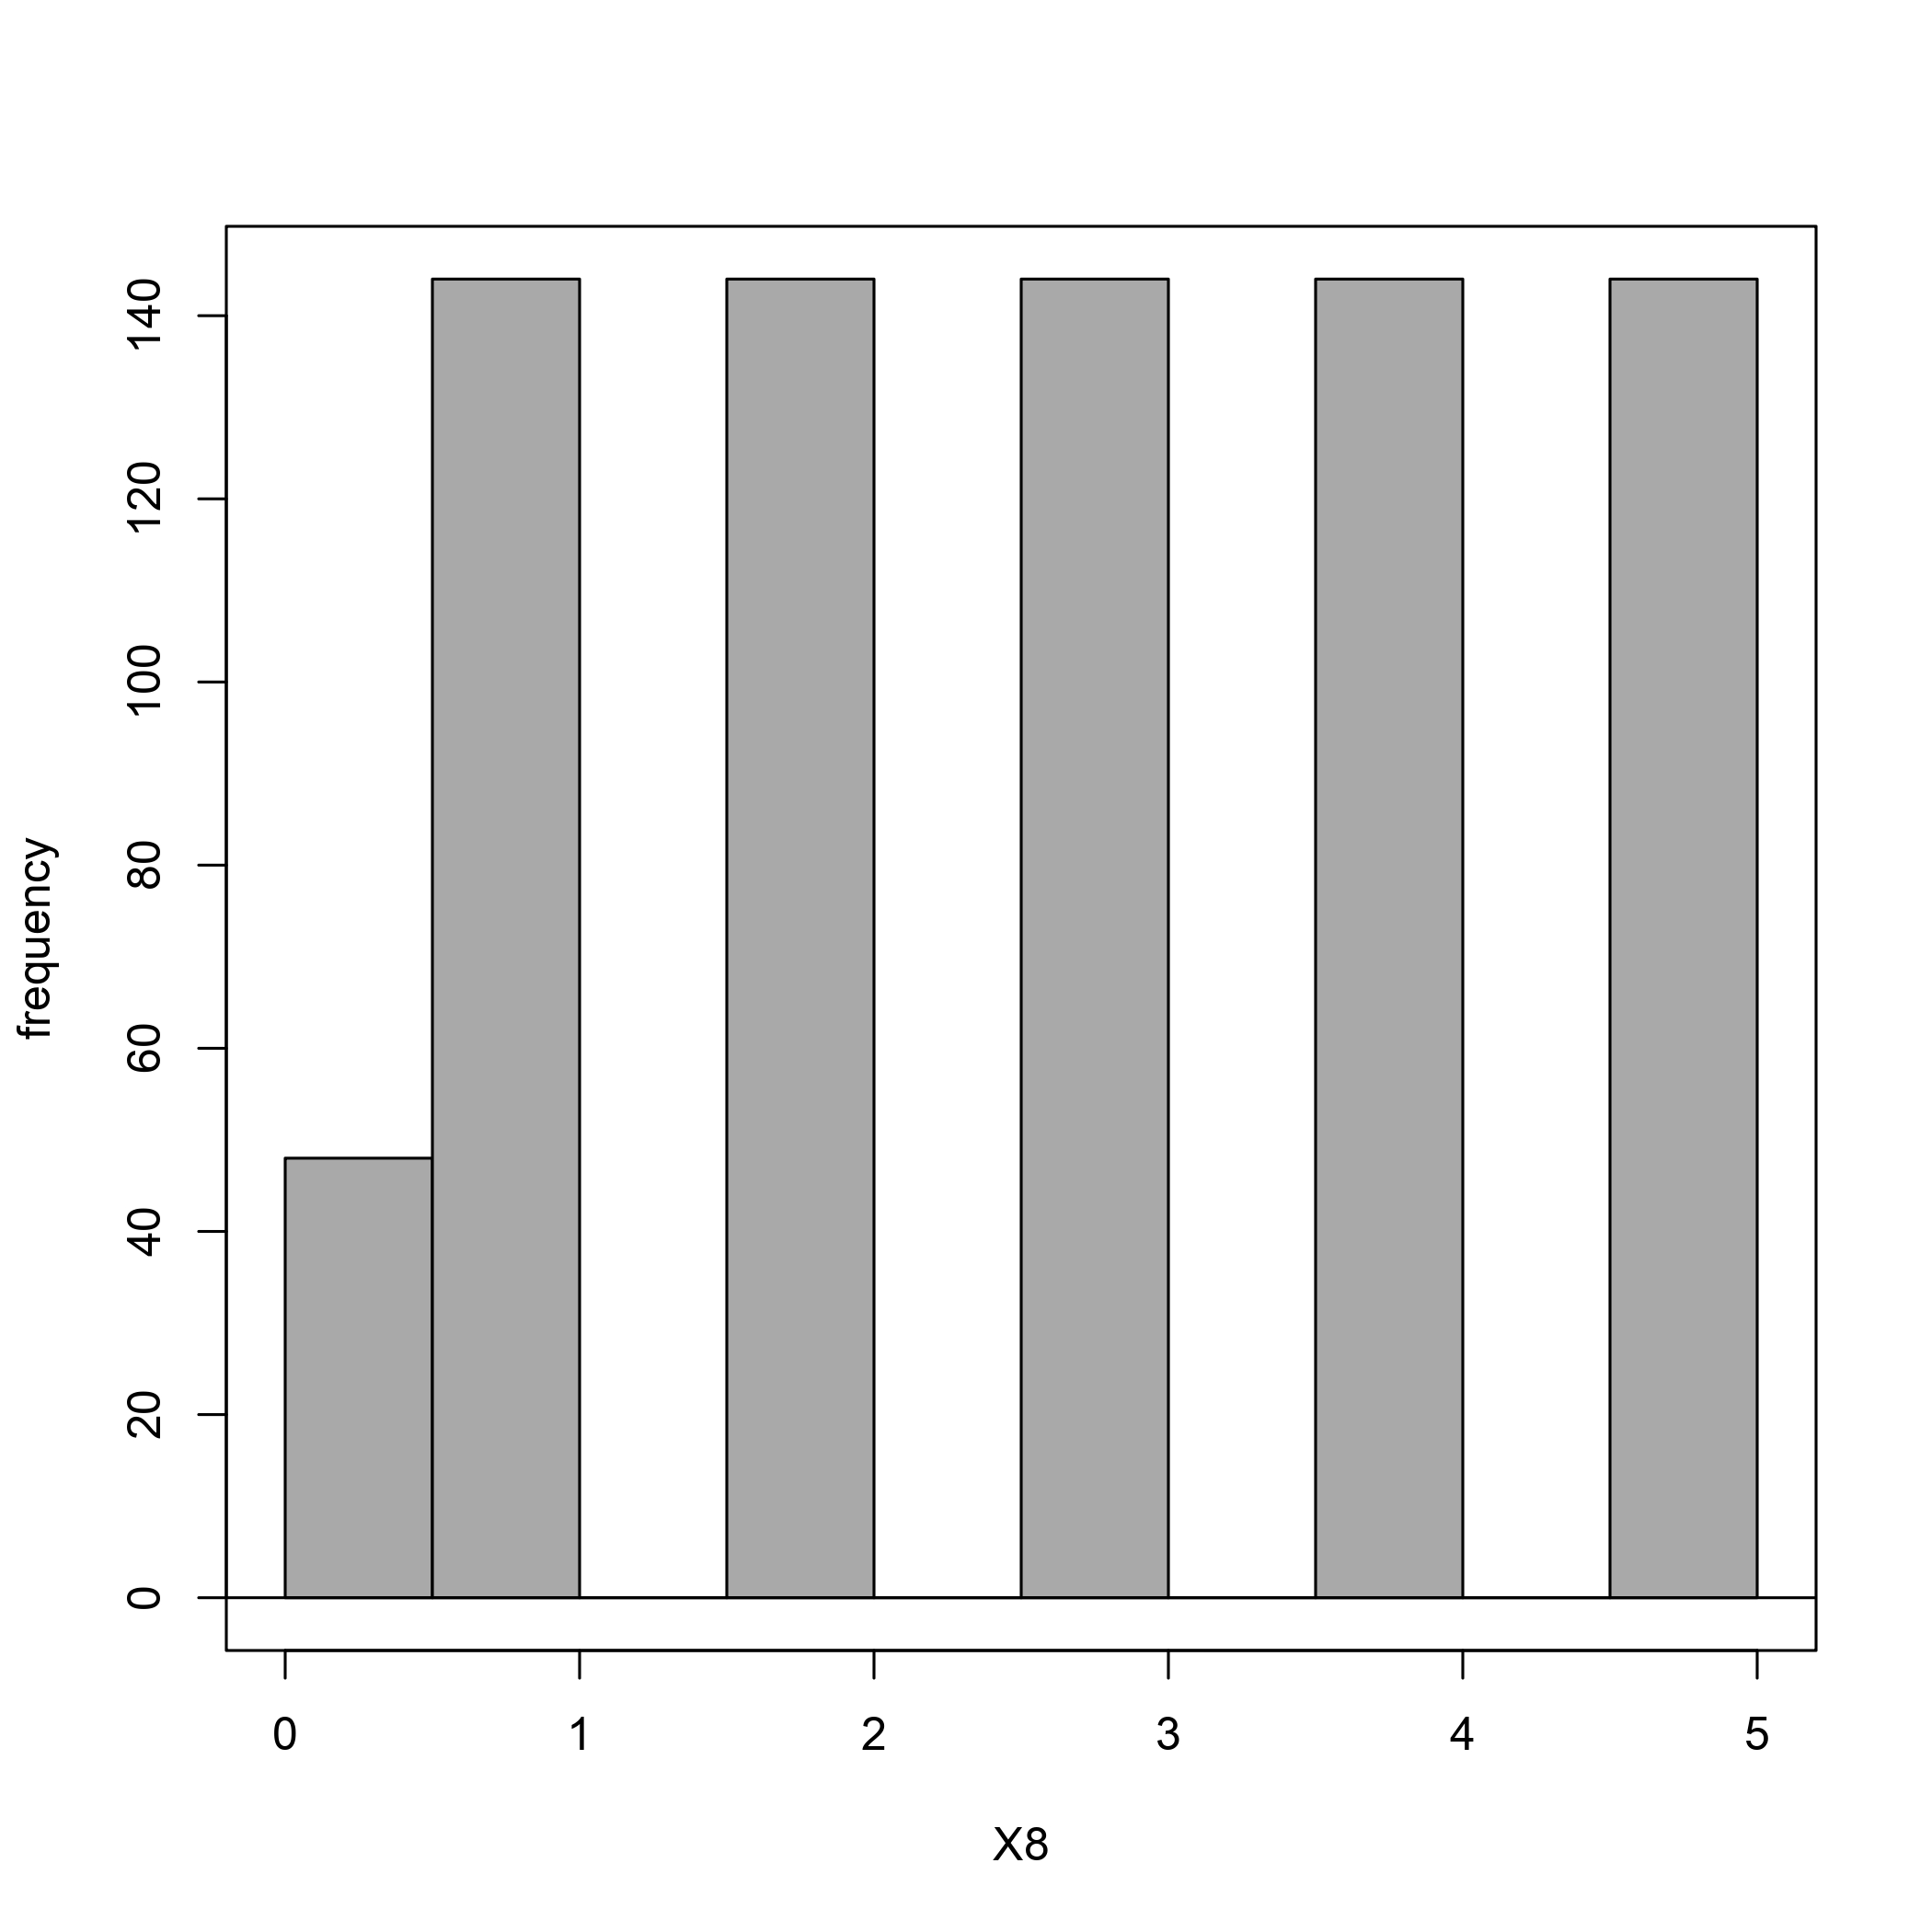
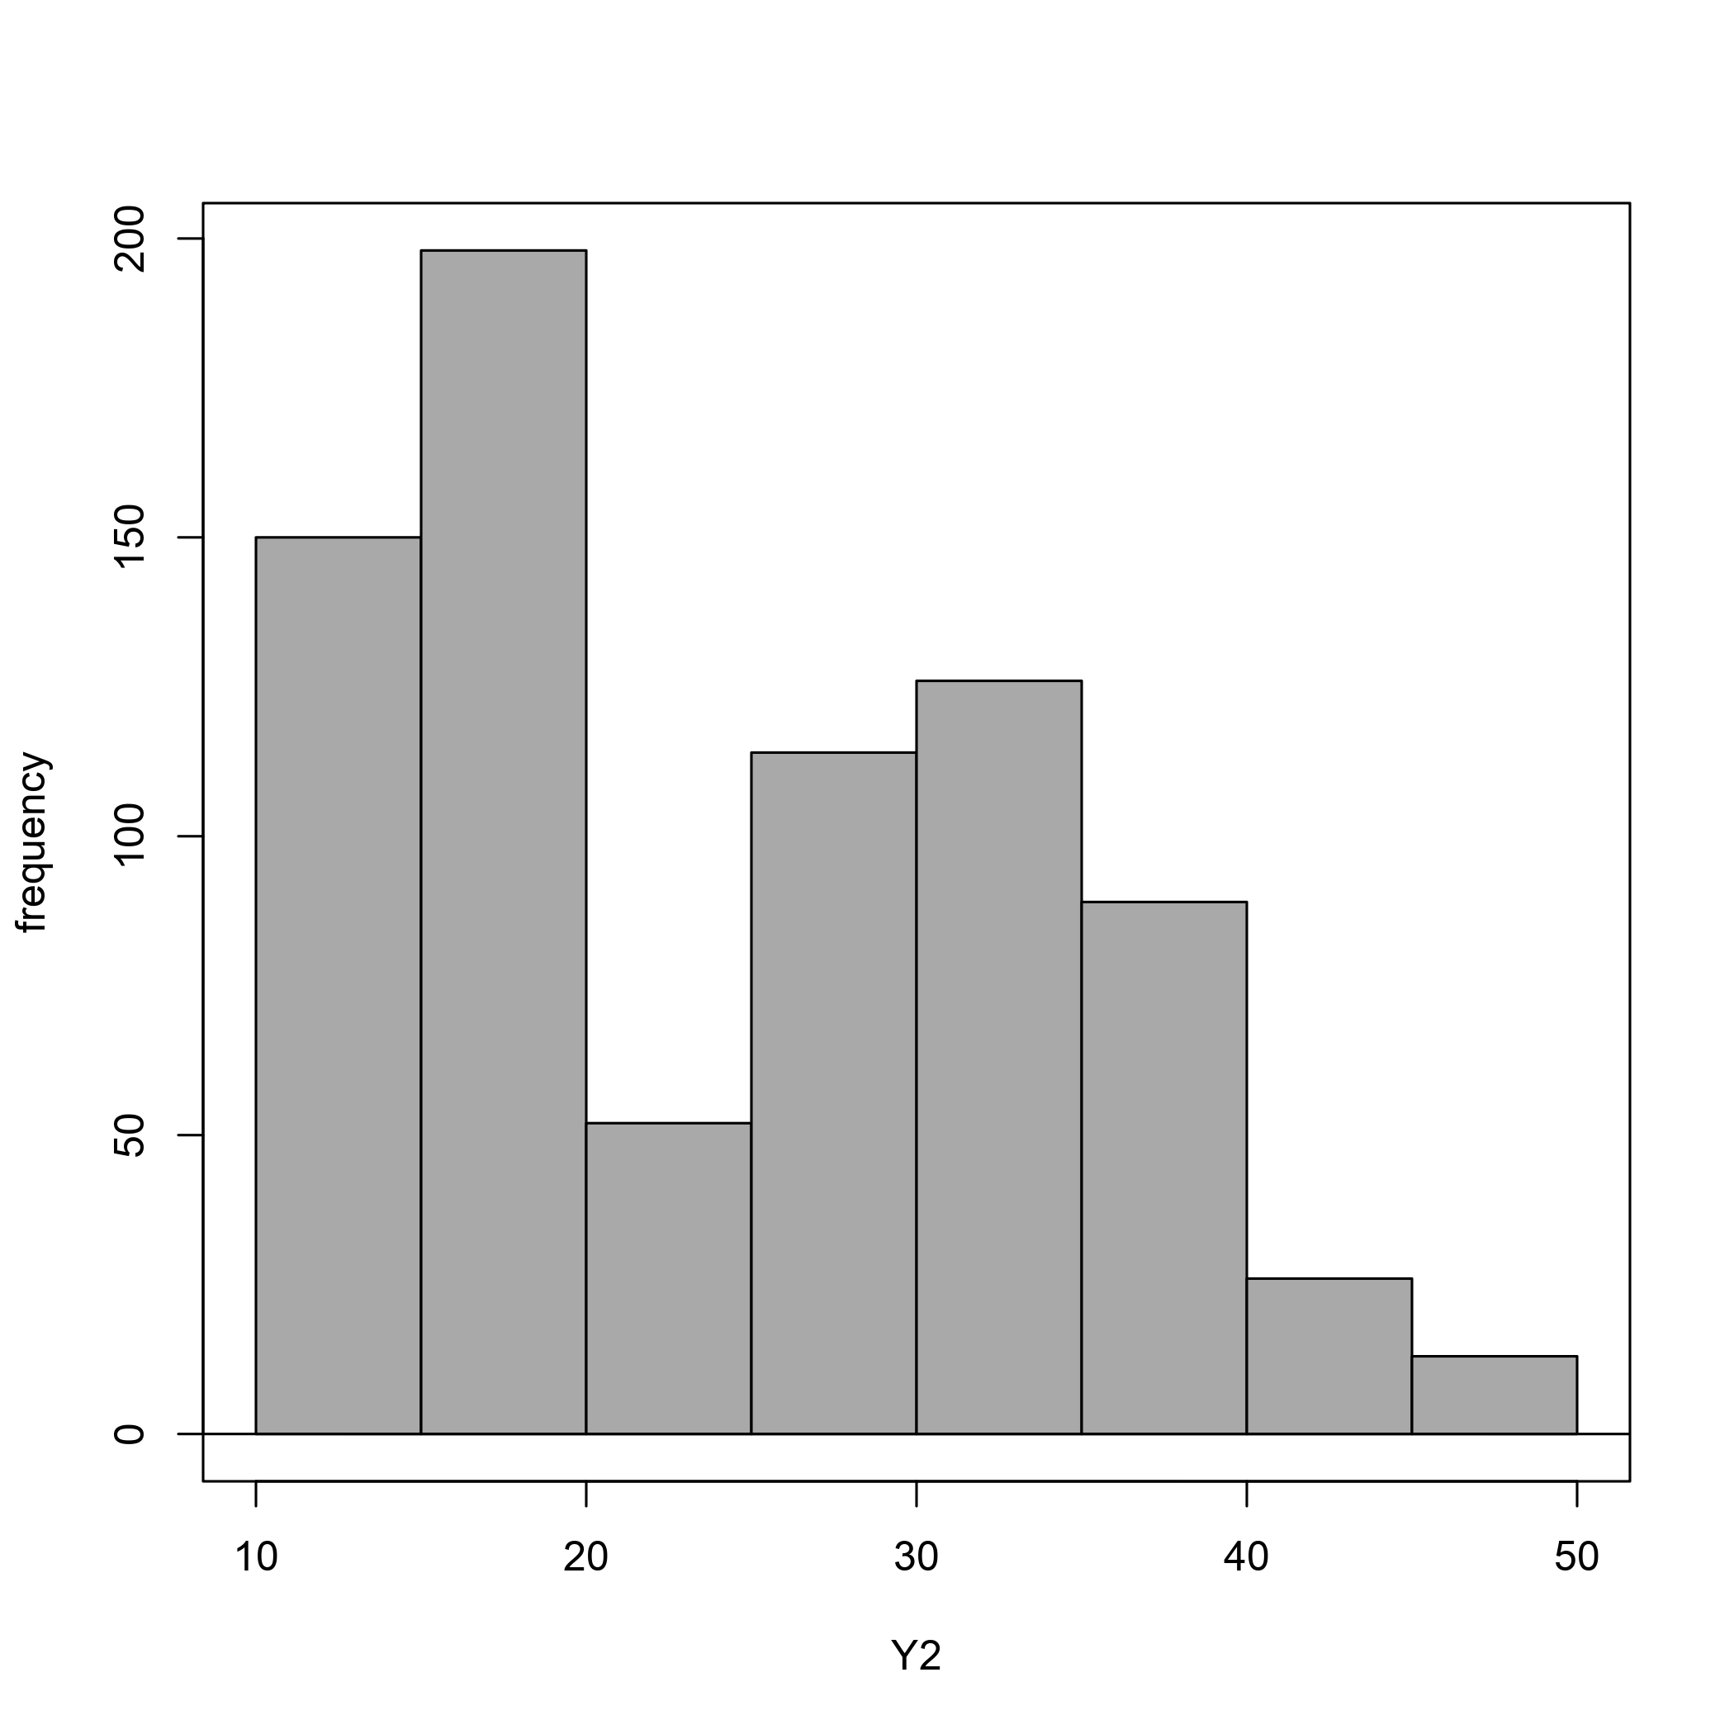
1b)- Histogram for each variable

Slide 4
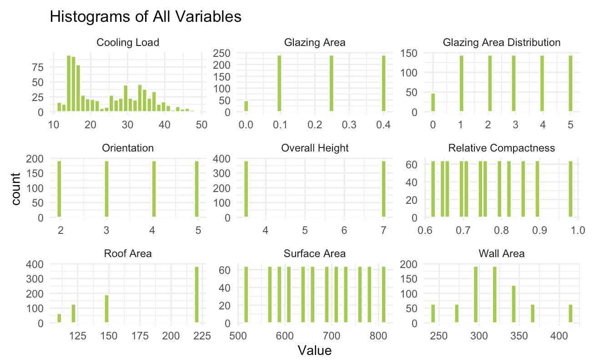

Slide 5
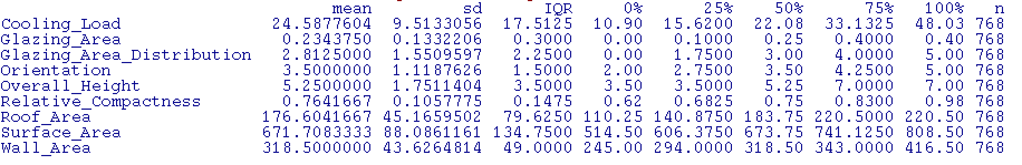
2a)- Descriptive statistics

Slide 6
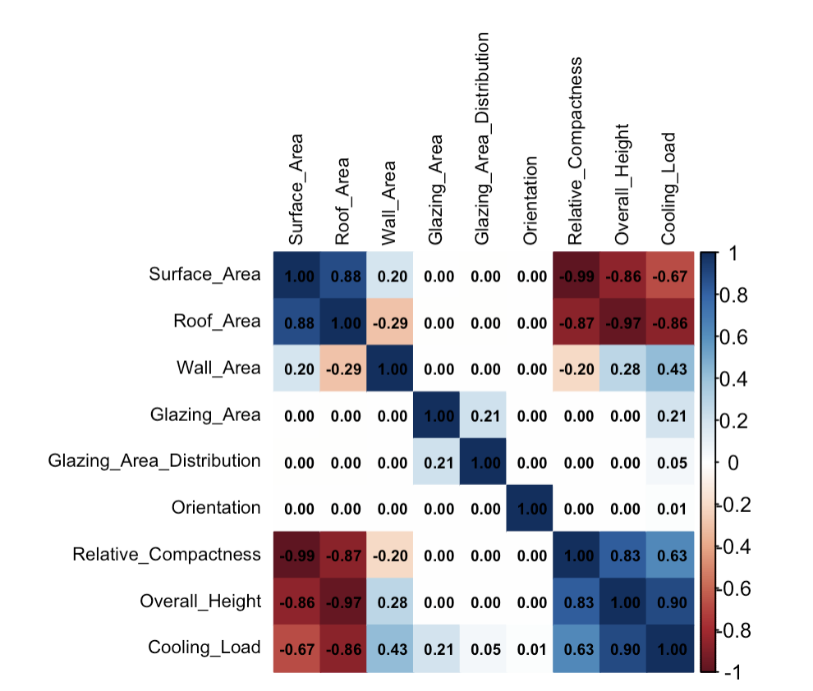
2b)- Correlation
Strongest
Negative Relationship
Surface Area & Relative Compactness
Strongest
Positive Relationship
Cooling Load & Overall Height

Slide 7
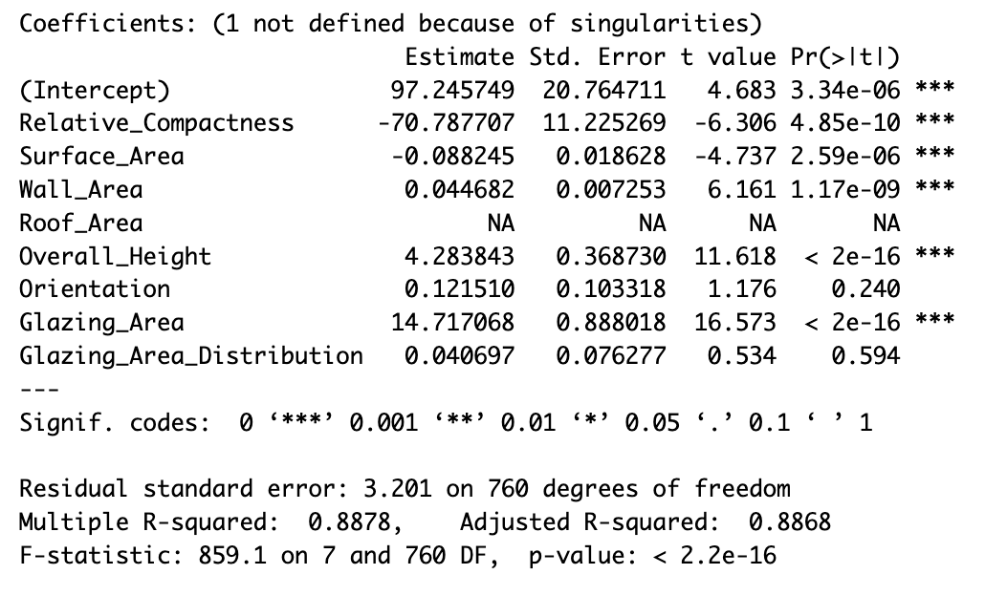
2c)- Linear Regression for Cooling Load
Roof Area shows NA , which means completely multicollinearity

Slide 8
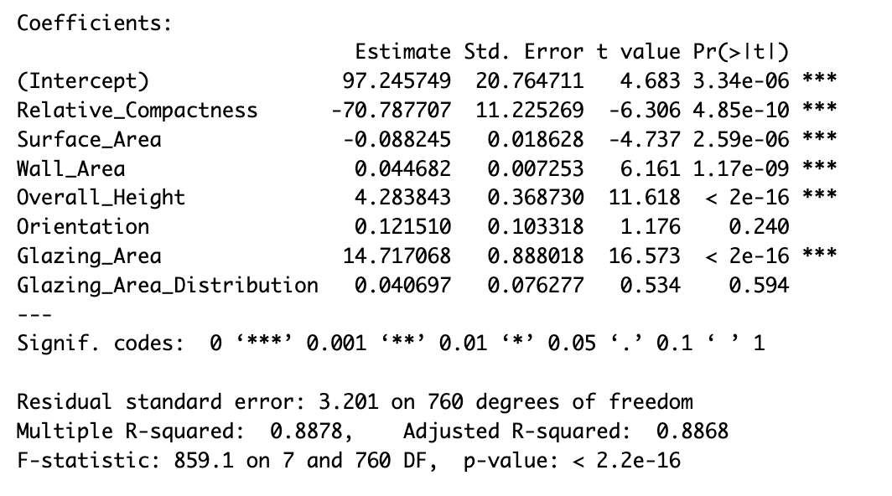
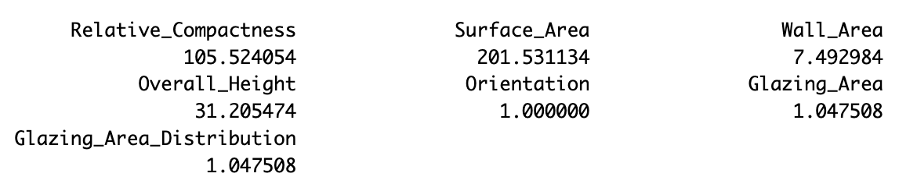
2d)- VIF analysis
Relative Compactness, Surface Area ad Overall Height > 10, so there are multicollinearity between these three variables

Slide 9
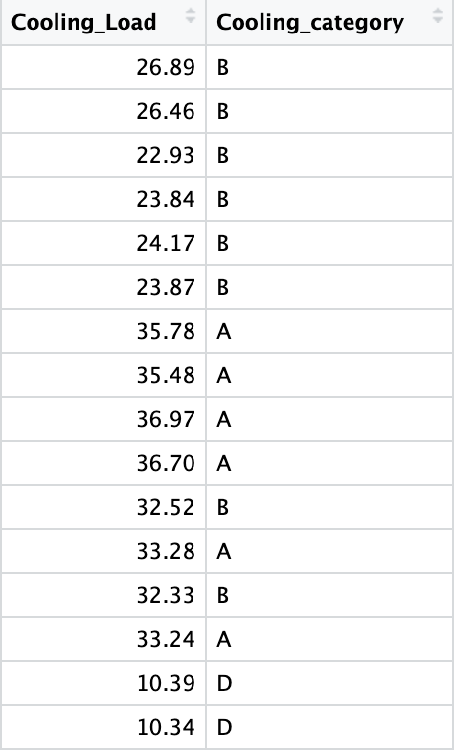
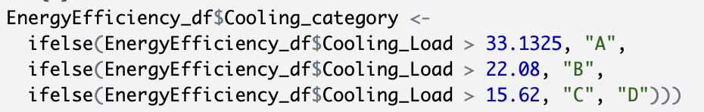
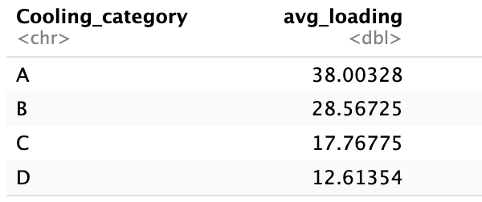
3a)- Assign categories for Cooling Load ( A for highest quartile, B for second highest quartile, C for third highest quartile, D for lowest quartile)
Worst Efficiency

Slide 10
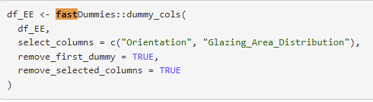
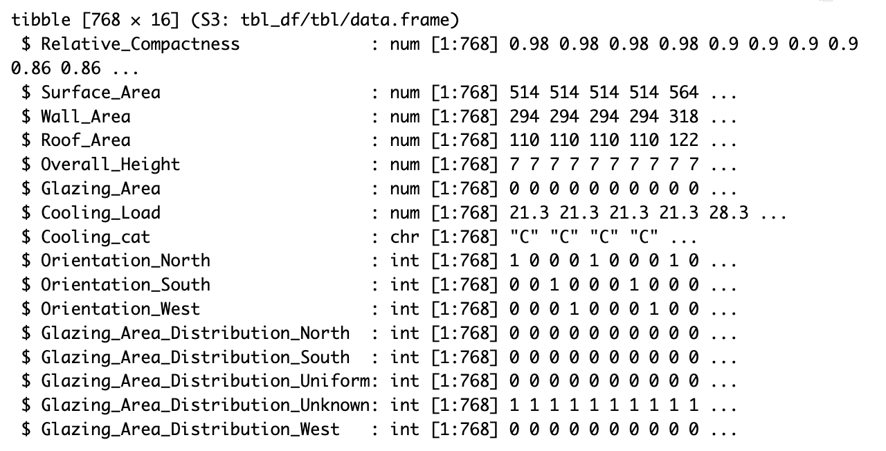
Convert “Orientation” and “Glazing Area Distribution” to dummy variables
Dummy for orientation
Dummy for glazing area distribution

Slide 11
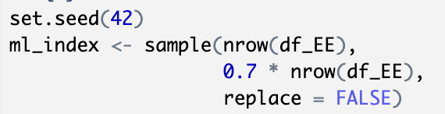
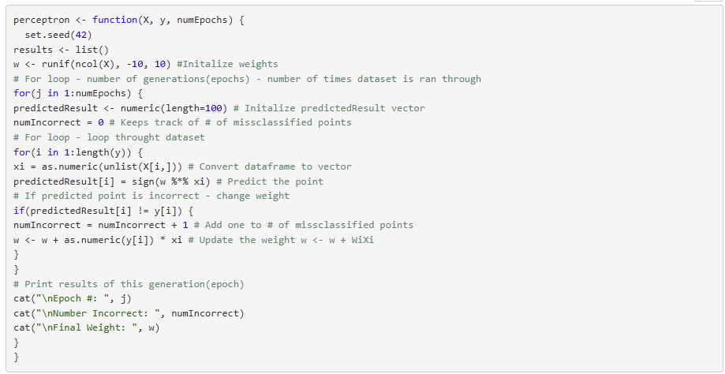
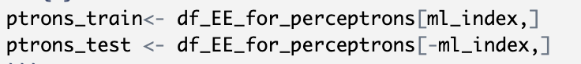
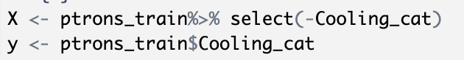
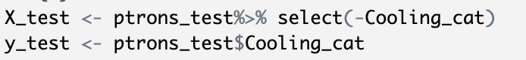
3b)- Create 5 perceptrons for Cooling Load (assign 1 for categories A &B, -1 for categories C&D)
Assign categories
Delete cooling load column
Create the training and testing data
Notes:
prerequisite

Slide 12
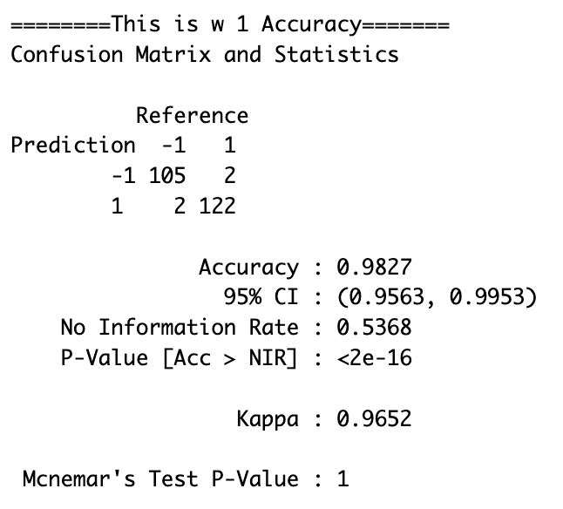
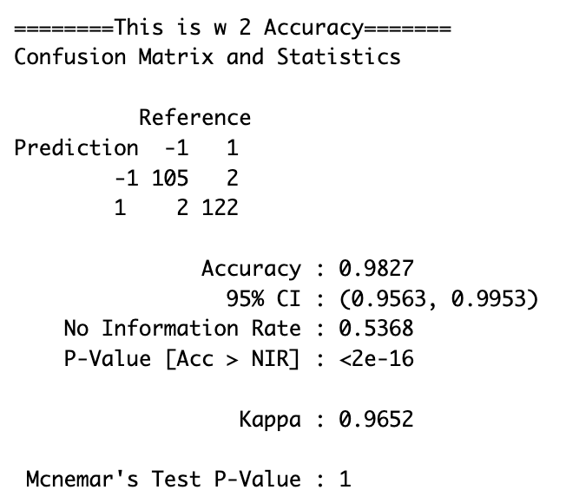
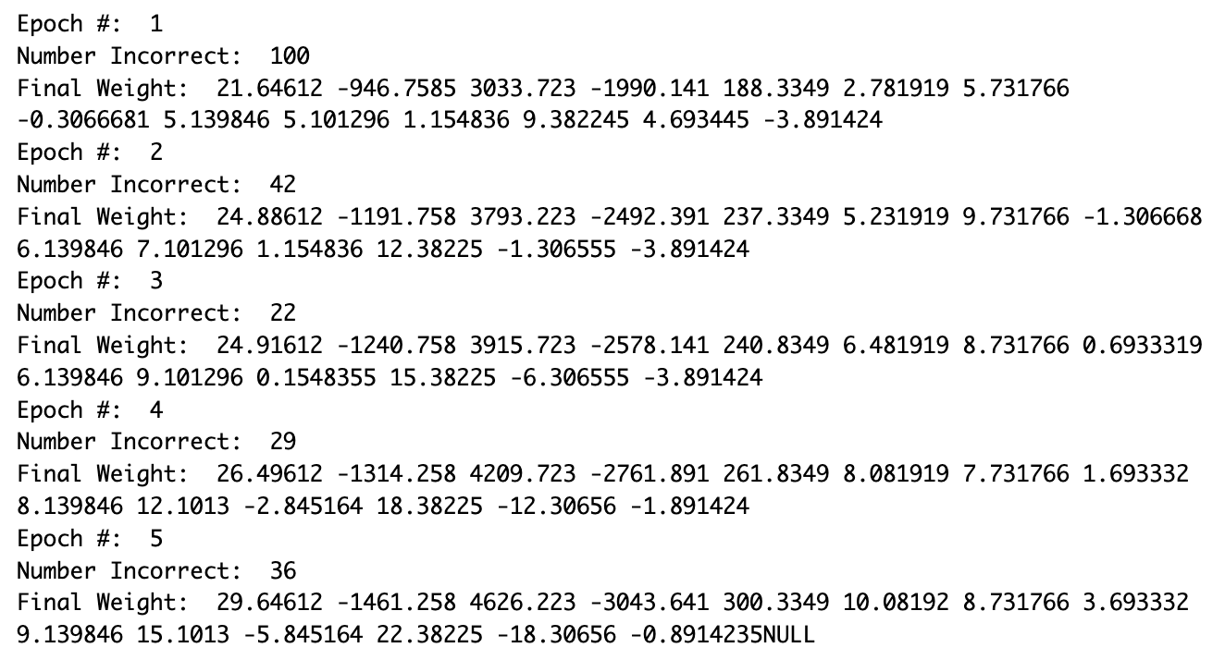


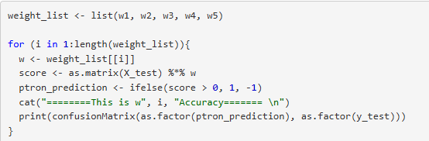

3b)- Output and Accuracy

Slide 13
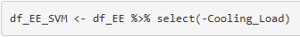
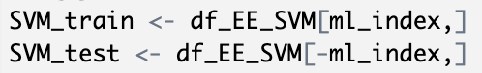
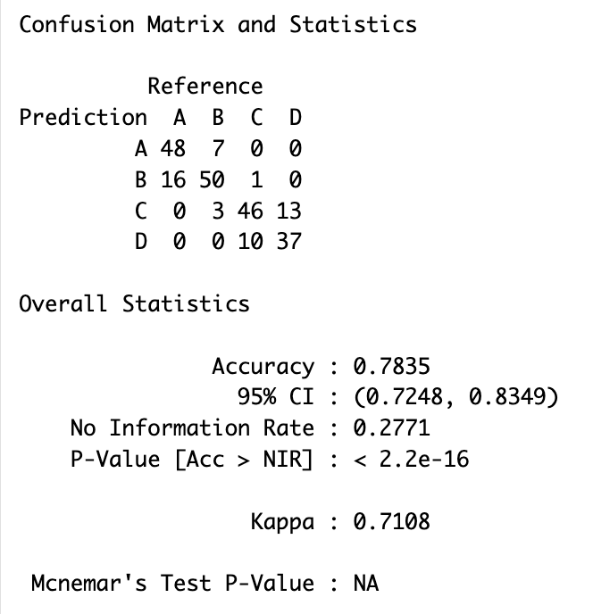
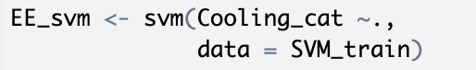
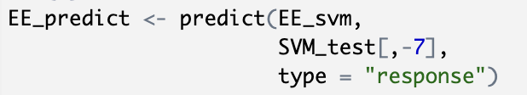
3c)- Create a SVM for Cooling Load(category)
Convert category to factor
Create the training and testing data
Run SVM
Make the prediction
Accuracy : 0.7835

Slide 14
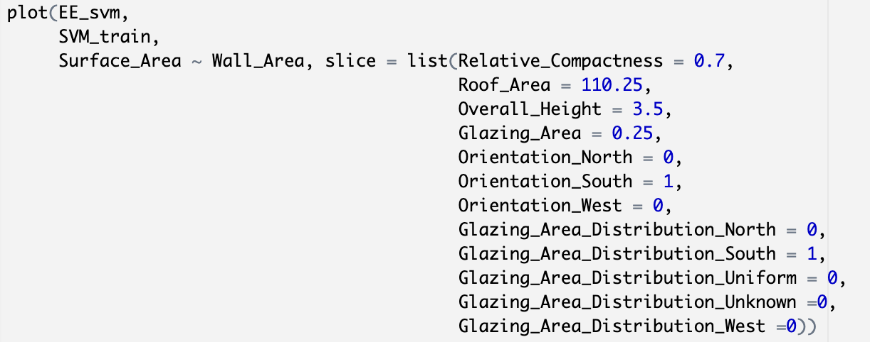
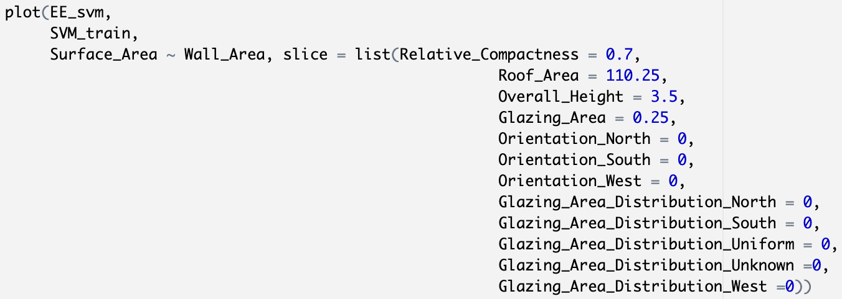
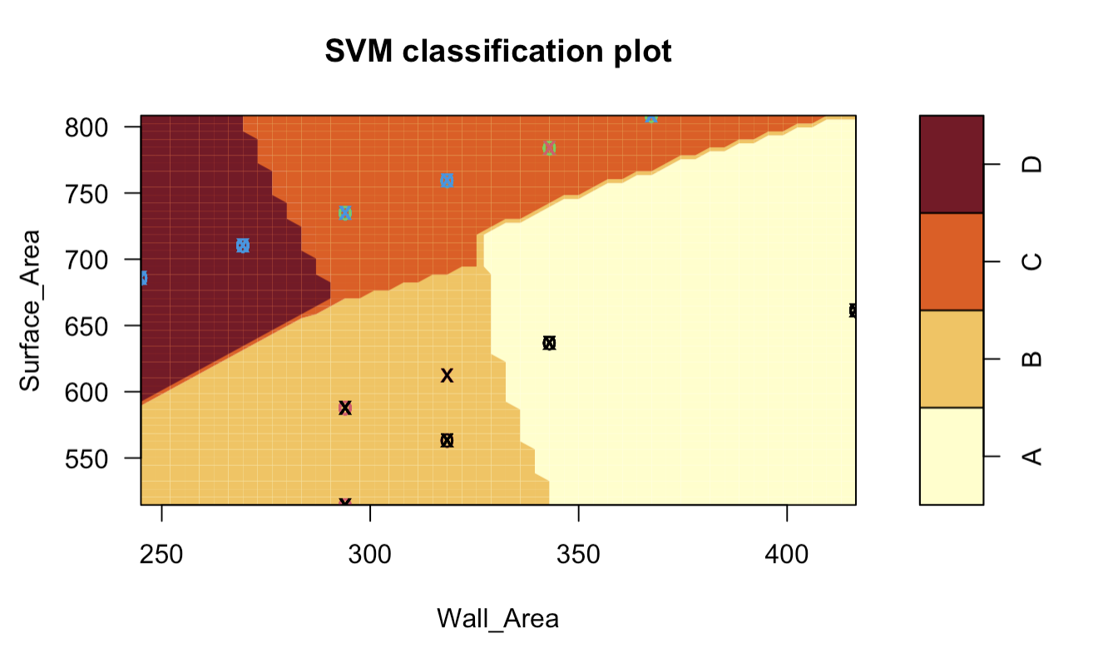
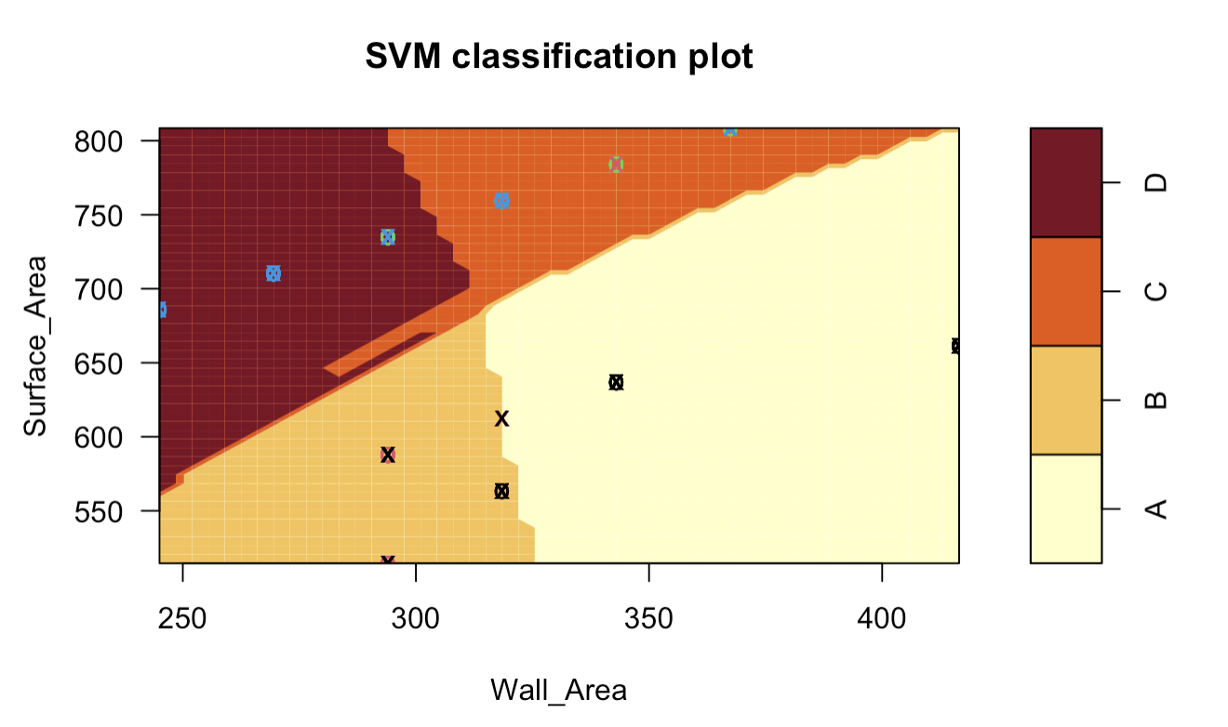
3c)- Graph for SVM

Slide 15
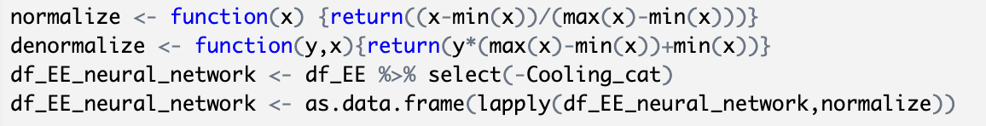
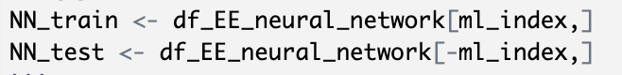
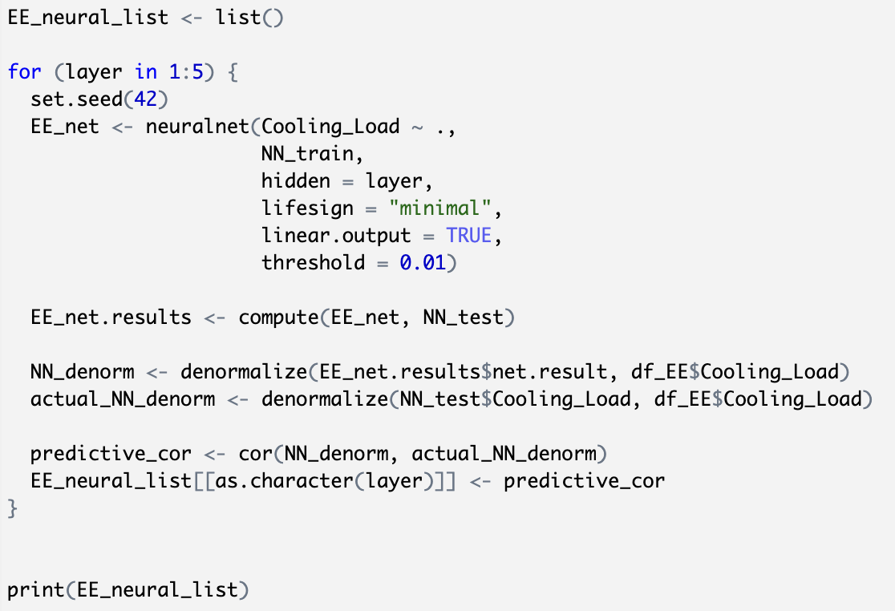
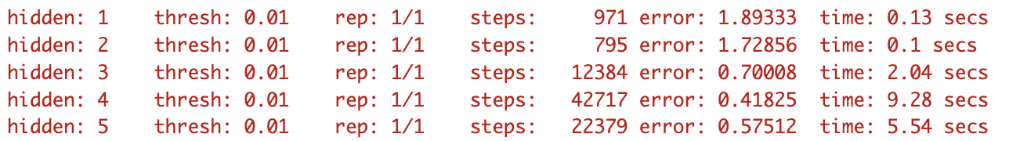
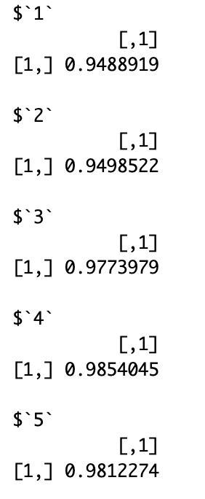
3d)- Create Neural Network from 1 to 5 hidden nodes (cooling load, continuous variable)
Create normalize and denormalize
Create the training and testing data
Correlation :
Run Neural Network
(using loop for 1 to 5)

Slide 16
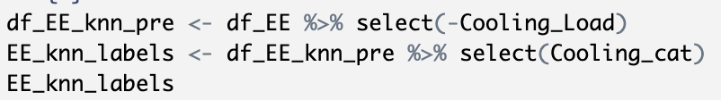
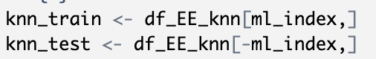
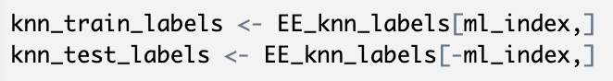
3e)- Create two K-nearest neighbor analysis for Cooling Load (category)
Remove the Cooling_Load and assign to a new dataset
Extract Cooling_cat as label and normalize the dataset

Slide 17
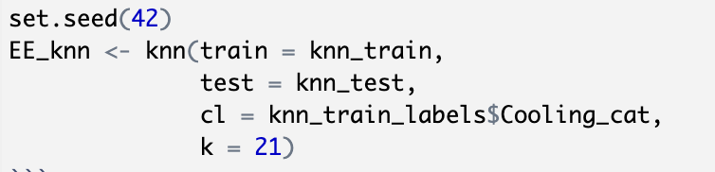
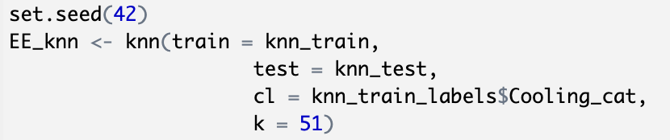
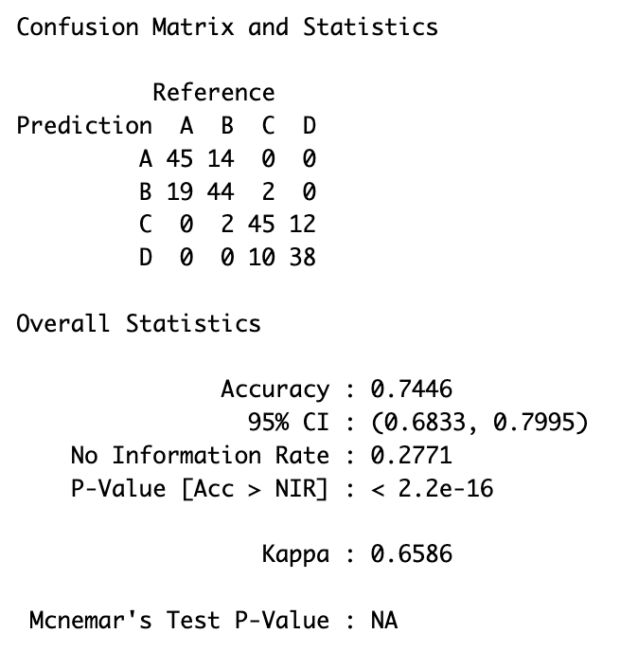

3e)- Output and Accuracy of KNN

Slide 18



3f)- Create Naïve Bayes analysis for Cooling Load (category)
Delete the cooling load column
Run Naïve Bayes Model

Slide 19




3f)- Output and Accuracy of Naïve Bayes
Accuracy : 0.5152

Slide 20




3g)- Create Decision Tree for Cooling Load (assign 1 for categories A &B, 0 for categories C&D)
Assign categories
Run
Decision Tree
Accuracy : 0.9827

Slide 21




3g)- Create Random Forest for Cooling Load (assign 1 for categories A &B, 0 for categories C&D)
Run
Random Forest
Accuracy : 1-1.86% = 98.14%

Slide 22


3g)- Create Random Forest for Cooling Load (assign 1 for categories A &B, 0 for categories C&D)
Accuracy : 0.9827

Slide 23








3i)- Create Boosting model for Cooling Load
Relative Compactness is the most important variable
Run
Boosting Model
Accuracy : 0.9784

Slide 24
3j)- Summarize the accuracy of all models
Technique | Target Variable | Accuracy | P-value
Perceptron 1-5 | Cooling_cat (A/B: 1 vs C/D : -1) | 0.9827 | 2e-16
SVM | Cooling_cat | 0.7835 | 2.2e-16
KNN(K=21) | Cooling_cat | 0.7446 | 2.2e-16
KNN(K=51) | Cooling_cat | 0.7532 | 2.2e-16
Naïve Bayes | Cooling_cat | 0.5152 | 1.937e-14
Decision Tree | Cooling_bi (A/B :1 vs C/D :0) | 0.9827 | 2e-16
Random Forest | Cooling_bi | 0.9827 | 2e-16
Boosting | Cooling_bi | 0.9784 | 2e-16

Slide 25
3j)- Summarize the correlation of all models
Technique | Target Variable | Correlation
Neural Network Node = 1 | Cooling_Load | 0.9489
Neural Network Nodes =2 | Cooling_Load | 0.9499
Neural Network Nodes = 3 | Cooling_Load | 0.9774
Neural Network Nodes = 4 | Cooling_Load | 0.9854
Neural Network Nodes = 5 | Cooling_Load | 0.9812

Slide 26
4)- List of Lessons Learned
a)- What technique worked best?
Technique | Accuracy | P-value
Perceptron | 0.9827 | 2e-16
Decision Tree | 0.9827 | 2e-16
Random Forest | 0.9827 | 2e-16
Technique | Target Variable | Correlation
Neural Network Nodes = 4 | Cooling_Load | 0.9854

Slide 27
4)- List of Lessons Learned
b)- What insights do you have for builders of energy efficient buildings?
According to linear regression analysis, we found Relative Compactness, Surface Area, Wall Area, Overall Height, and Glazing Area are all significant, which means these variables will impact cooling load.
In addition, according to Decision Tree and XGboosting analysis, it indicates Relative Compactness is the most important variables.
Furthermore, based on the Random Forest variable importance analysis, we observe that Glazing Area emerges as the most critical feature, slightly ahead of Relative Compactness. Other variables such as Surface Area, Overall Height, and Roof Area also demonstrate importance scores, reinforcing the insights obtained from linear regression analysis except for “Roof Area”
Even though Roof_Area was eliminated in the linear regression model due to perfect multicollinearity, it still contributes to the Random Forest model I believe it’s because Random Forest is not based on linear assumptions.
Additionally, by applying SVM slice visualization, we can fix non-target variables and strategically adjust key features to explore how specific changes can lead to improved energy efficiency outcomes.

Slide 28


4)- List of Lessons Learned
b)- What insights do you have for builders of energy efficient buildings?

Slide 29
Thanks!
Group 6 :
ChihHao Luca Yuan
Ching Yu Hsu

